Slide 1
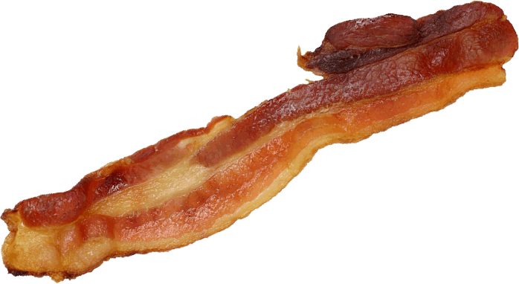
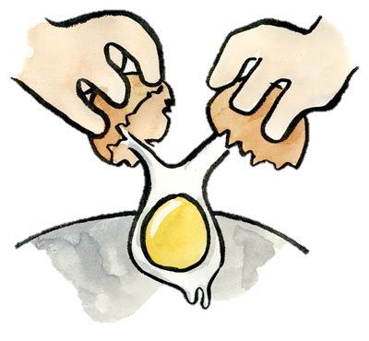
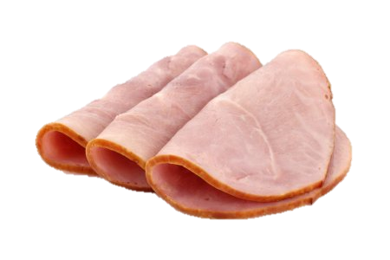
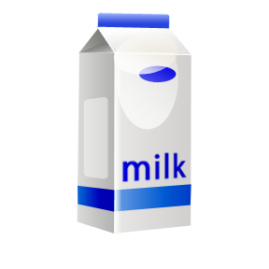


Food
Today is .........................................................................
★ Vocabulary
bread
butter
bacon
ham
milk
eggs
coffee
cheese
Vegetables
potatoes
beans

Slide 2
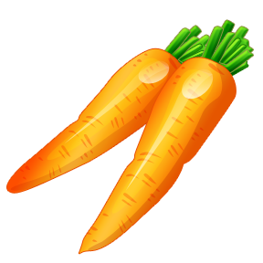

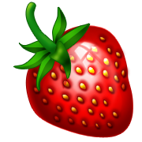



carrots
peas
Fruits
a strawberry
- strawberries
an apple
a banana
a lemon
an orange
★ Sentences
Do you like bacon ?
Yes I do.
Do you like eggs ?
No, I don’t (= do not).
What’s your favorite food ?
My favorite food is ham.
Do you love apples ?
Yes I do.
Do you love beans ?
No, I don’t (= do not).
Do you prefer peas ?
Yes I do.
Do you prefer bananas ?
No, I don’t (= do not).

