Slide 1
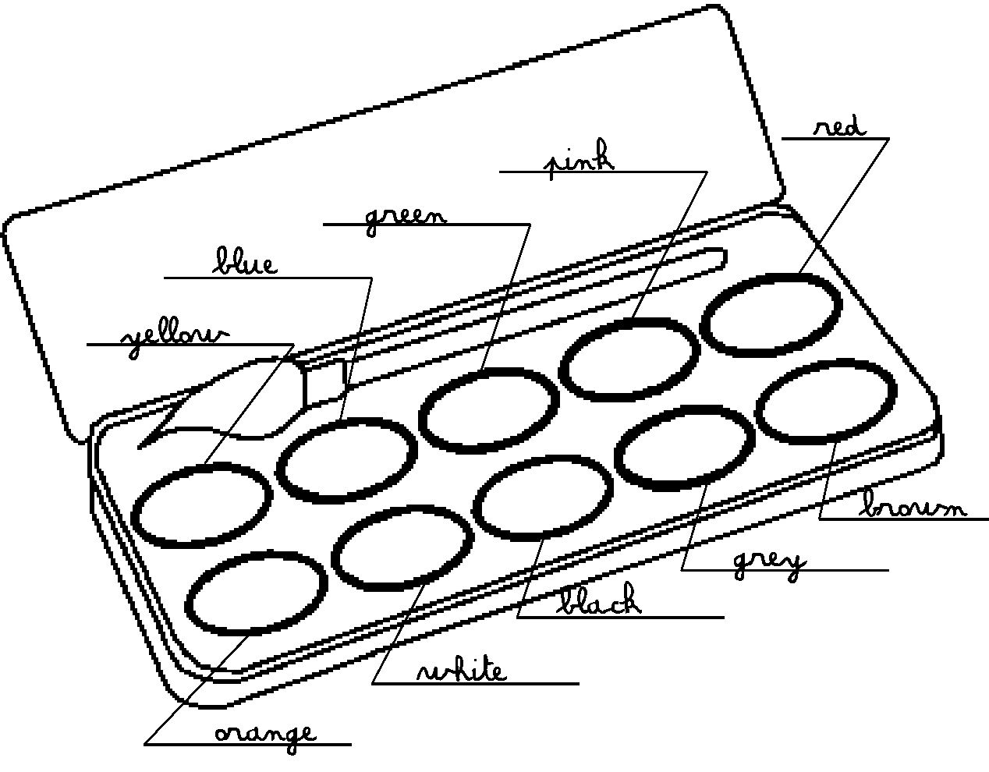
Colours
Today is ...............................................................
★ Vocabulary
★ Sentences
What‘s your favorite colour ?
My favorite colours is red.
It’s red.
Do you like green ?
Yes I do. / No, I don’t.
Do you love purple ?
Yes I do. / No, I don’t.
Do you prefer blue ?
Yes I do. / No, I don’t.

