Slide 1





MATHIEU
CECILIA
LOUNA
ELSA

Slide 2

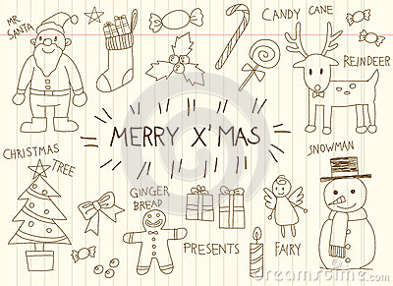


Lola
Ludivine
Margot
Luca

Slide 3


NOLAN
NoAH
THIBAUT
Brayan
Brayan

Slide 4
Leo
MATHIS
LEA
TIMEO
Noah
Cécilia

Slide 5
ALICIA
ELEONA
LILOU
EVA

