Slide 1
How Are You?

Slide 2
How are you? How are you?
I'm happy

Slide 3
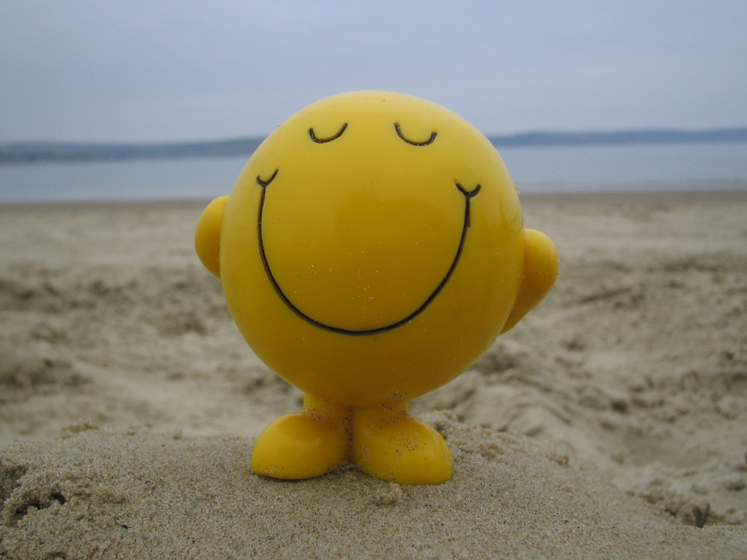
How are you? How are you?
I'm happy, too

Slide 4
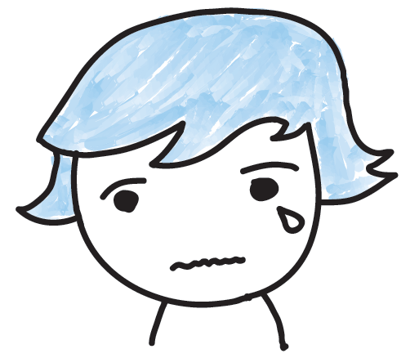
How are you? How are you?
I'm sad

Slide 5
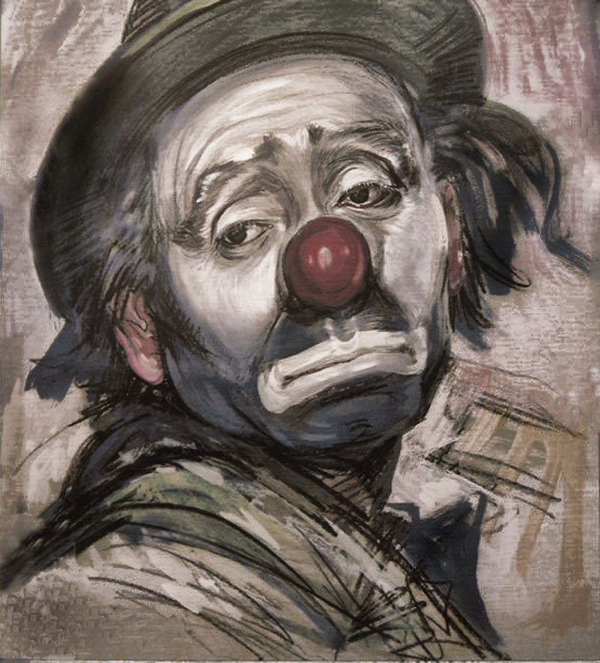
How are you? How are you?
I'm sad, too

Slide 7
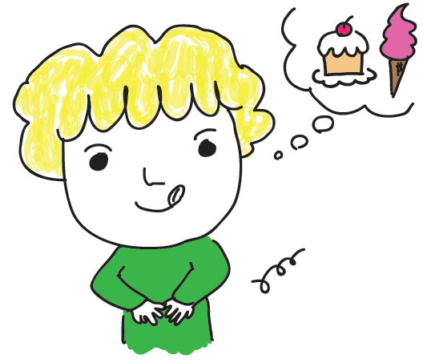
How are you? How are you?
I'm hungry

Slide 8
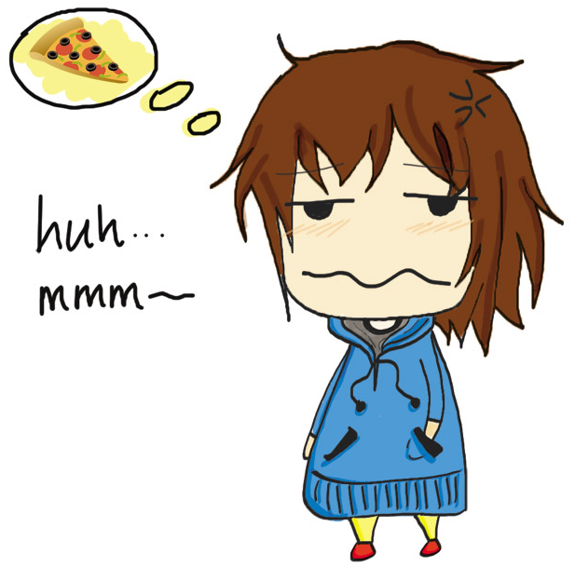
How are you? How are you?
I'm hungry, too
Image by Para6iT

Slide 9
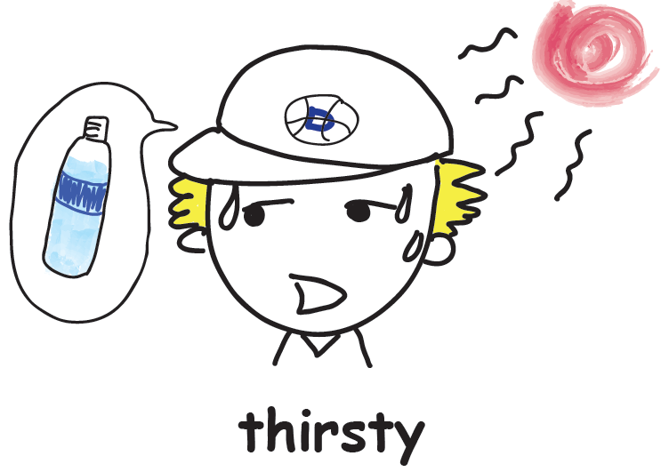
How are you? How are you?
I'm thirsty

Slide 10
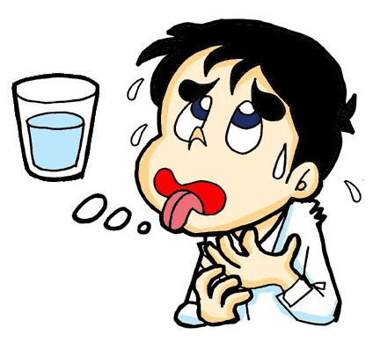
How are you? How are you?
I'm thirsty, too

Slide 12
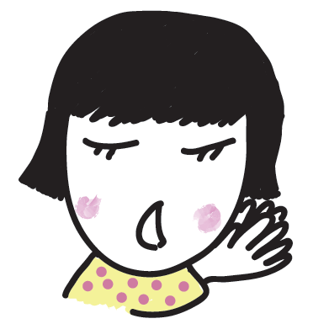
How are you? How are you?
I'm sleepy

Slide 13
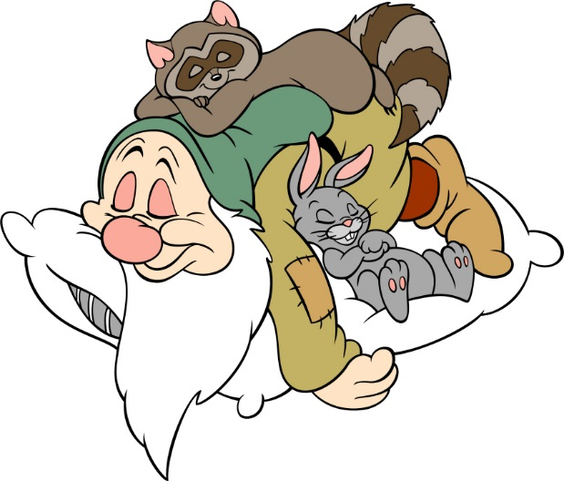
How are you? How are you?
I'm sleepy, too

Slide 14
How are you? How are you?
I'm great!

Slide 15
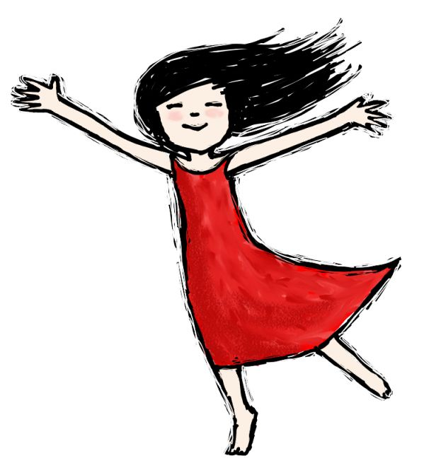
How are you? How are you?
I'm great, too !

