Slide 1
Halloween
Découverte du monde – Anglais
⇨ Halloween colours

Slide 2
Let’s listen to a song !

Slide 3
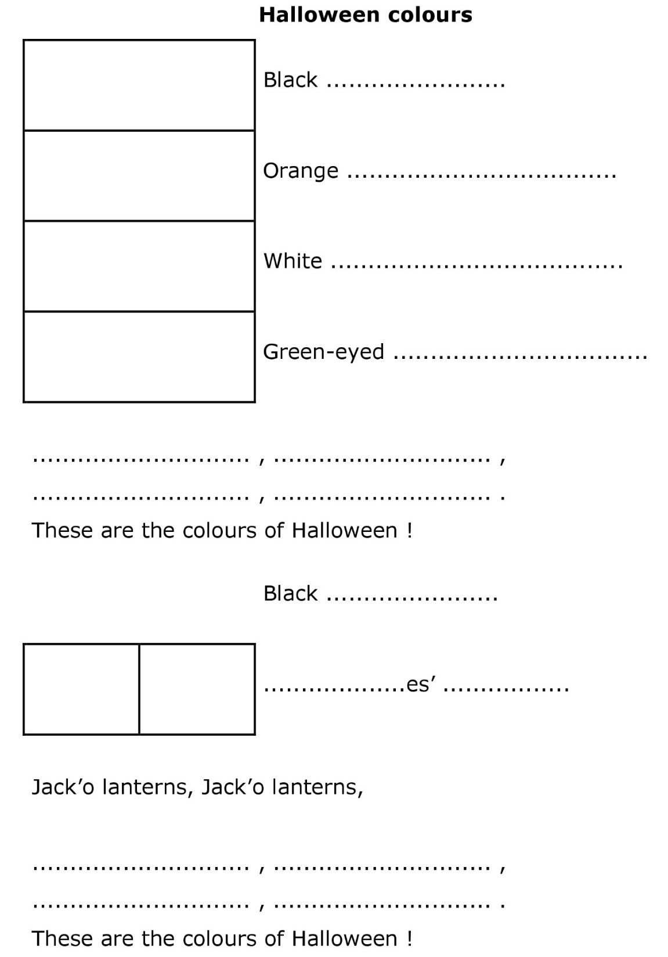
Listen to the song and stick the pictures.

Slide 4
Listen to the song again and write the words.

Slide 5
Let’s correct the exercise.

Slide 6
cat
pumpkin
ghost
monster
Black
orange
white
green

Slide 7
cats
witch
hats
Black
orange
white
green

Slide 8
Now, let’s sing the song !

