Slide 1
Les membres de la famille
Découverte du monde – Anglais
⇨ Structures

Slide 2
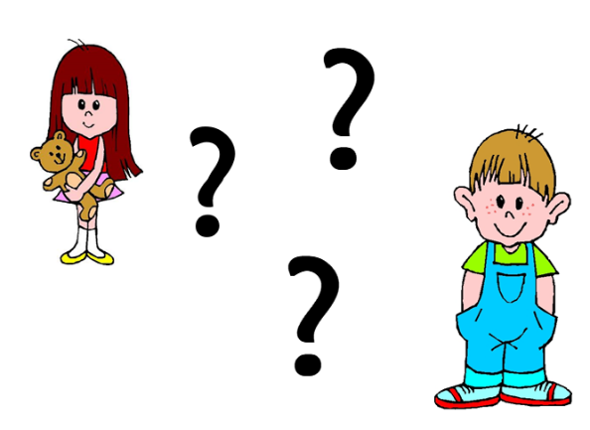
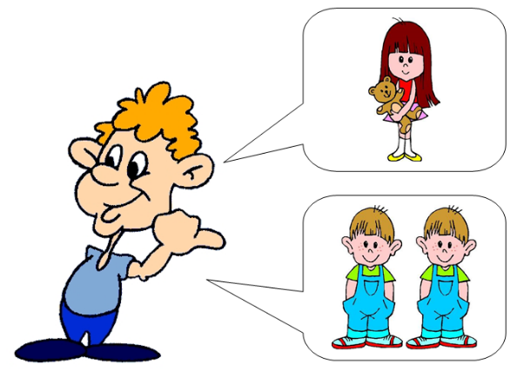
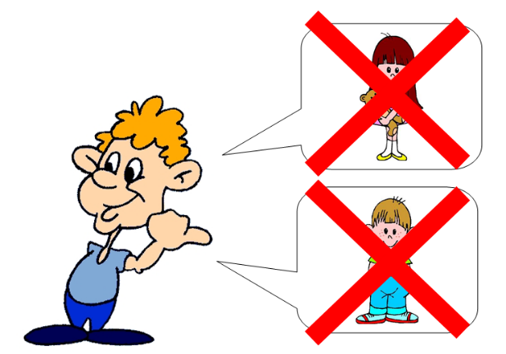
How many ... have you got ?
I have got...
I haven’t got any...

Slide 3
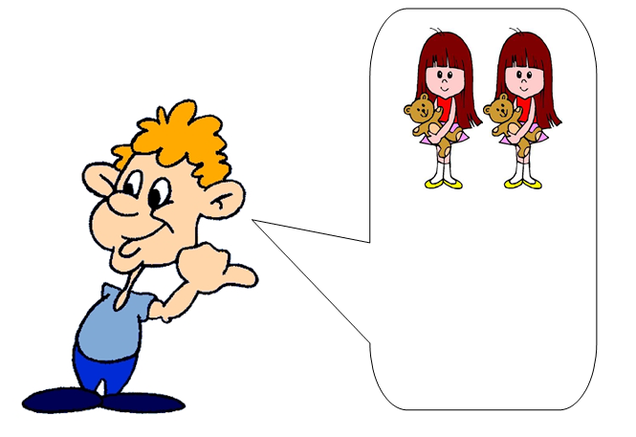
How many sisters have you got ?
I have got two sisters.

Slide 4
How many brothers have you got ?
I haven’t got any brother.

Slide 5
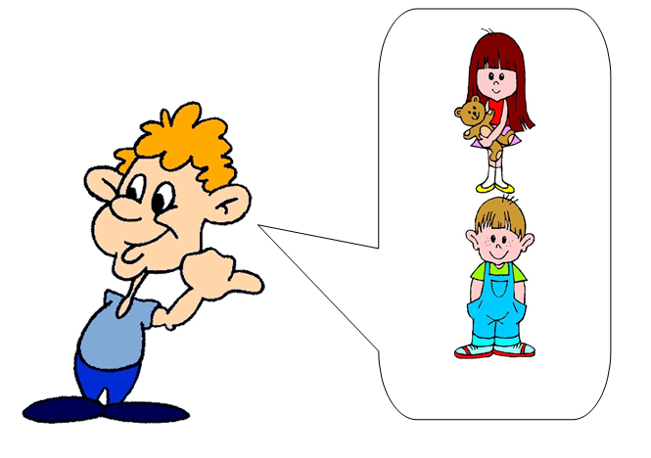
How many sisters have you got ?
I have got one sister.

Slide 6
How many brothers have you got ?
I have got one brother.

Slide 7
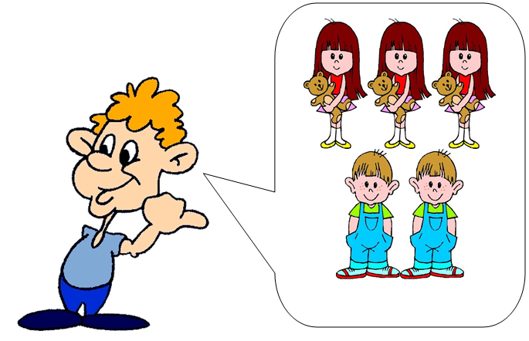
How many brothers or sisters have you got ?
I have got two brothers and three sisters.

Slide 8
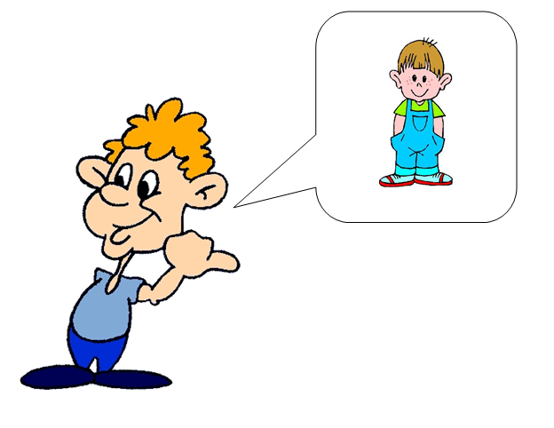
How many brothers or sisters have you got ?
I have got one brother but I haven’t got any sister.

