Slide 1
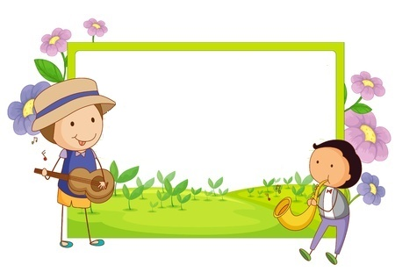
Ajouter retrancher 2

Slide 2
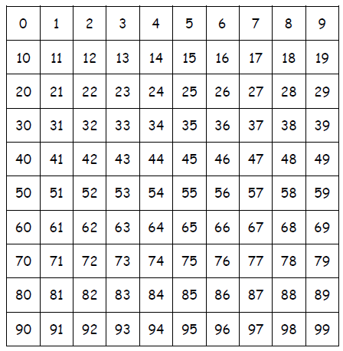
23 + 2 =
25

Slide 3
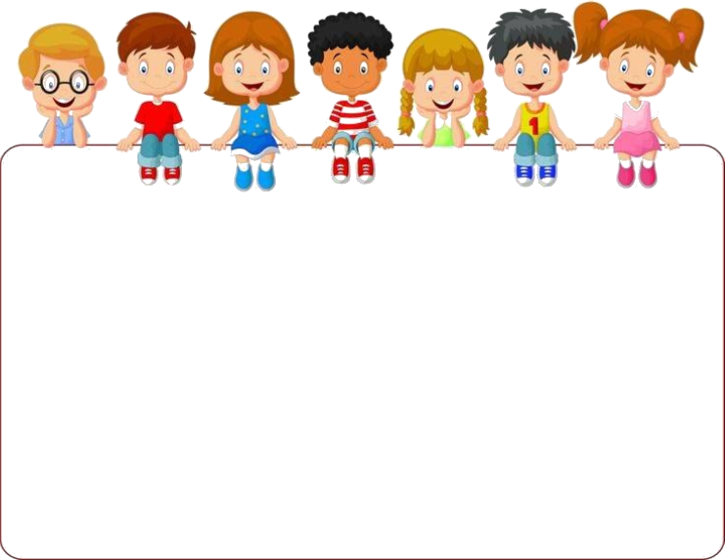
23 - 2 =
21

Slide 4
46 + 2 =
48

Slide 5
33 - 2 =
31

Slide 6
65 - 2 =
63

Slide 7
31 + 2 =
33

Slide 8
22 - 2 =
20

Slide 9
30 - 2 =
28

Slide 10
14 + 2 =
16

Slide 11
16 + 2 =
18

Slide 12
50 - 2 =
48

Slide 13
50 + 2 =
52

Slide 14
48 + 2 =
50

Slide 15
18 + 2 =
20

Slide 16
21 - 2 =
19

Slide 17
61 - 2 =
59

Slide 18
28 + 2 =
30

Slide 19
58 + 2 =
60

Slide 20
59 + 2 =
61

Slide 21
51 - 2 =
49

Slide 22
62 - 2 =
60

Slide 23
19 + 2 =
21

Slide 24
49 + 2 =
51

Slide 25
40 - 2 =
38

Slide 26
29 + 2 =
31

Slide 27
55 + 2 =
57

Slide 28
38 + 2 =
40

Slide 29
39 + 2 =
41

Slide 30
Ajouter 2 j’ai compris

Slide 31
22 - 2 =

Slide 32
35 + 2 =

Slide 33
30 - 2 =

Slide 34
25 - 2 =

Slide 35
50 + 2 =

Slide 36
31 - 2 =

Slide 37
54 + 2 =

Slide 38
18 + 2 =

Slide 39
54 - 2 =

Slide 40
51 - 2 =

Slide 41
Ajouter 2 correction

Slide 42
22 - 2 =
20

Slide 43
35 + 2 =
37

Slide 44
30 - 2 =
28

Slide 45
25 - 2 =
23

Slide 46
50 + 2 =
52

Slide 47
31 - 2 =
29

Slide 48
54 + 2 =
56

Slide 49
18 + 2 =
20

Slide 50
54 - 2 =
52

Slide 51
51 - 2 =
49

