Slide 1
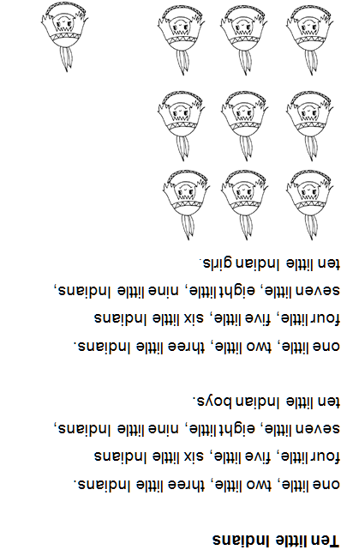
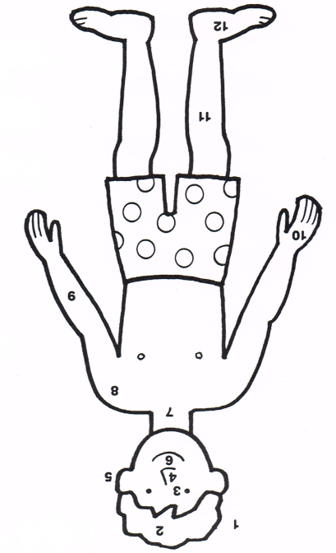
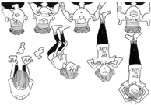
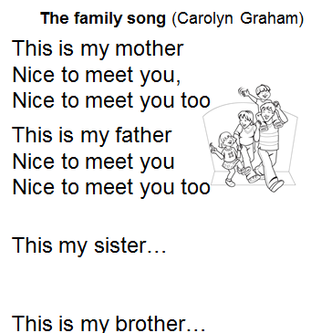
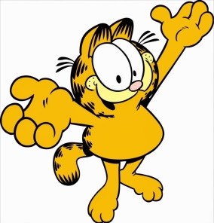
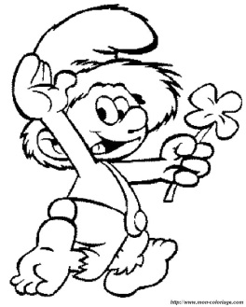
7 | My english book CP | Hello ! How are you ? Very nice to meet you Please tell me what’s your name Please, tell me what’s your name My name is………………. Welcome to ……………… ! 1 | 2 I am fine !
6
5
head
hair
eye
nose
ear
mouth
Neck
shoulder
arm
hand
leg
foot
4
3
Head, shoulders, knees and toes Knees and toes
Head, shoulders, knees and toes Knees and toes
Eyes, and ears, and mouth and nose
Head, shoulders, knees and toes
Knees and toes
See you soon!
Goodbye!

