Slide 1
SEPTEMBRE 2018
September 2018
lundi monday | mardi tuesday | mercredi wednesday | jeudi thursday | vendredi friday | samedi saturday | dimanche sunday
 |  |  |  |  | 1 | 2
3 | 4 | 5 | 6 | 7 | 8 | 9
10 | 11 | 12 | 13 | 14 | 15 | 16
17 | 18 | 19 | 20 | 21 | 22 | 23
24 | 25 | 26 | 27 | 29 | 29 | 30
Rentrée
Automne

Slide 2
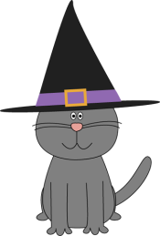
OCTOBRE 2018
October 2018
lundi monday | mardi tuesday | mercredi wednesday | jeudi thursday | vendredi friday | samedi saturday | dimanche sunday
1 | 2 | 3 | 4 | 5 | 6 | 7
8 | 9 | 10 | 11 | 12 | 13 | 14
15 | 16 | 17 | 18 | 19 | 20 | 21
22 | 23 | 24 | 25 | 26 | 27 | 28
29 | 30 | 31
Halloween

Slide 3
NOVEMBRE 2018
November 2018
lundi monday | mardi tuesday | mercredi wednesday | jeudi thursday | vendredi friday | samedi saturday | dimanche sunday
 |  |  | 1 | 2 | 3 | 4
5 | 6 | 7 | 8 | 9 | 10 | 11
12 | 13 | 14 | 15 | 16 | 17 | 18
19 | 20 | 21 | 22 | 23 | 24 | 25
26 | 27 | 28 | 29 | 30
Toussaint
Armistice

Slide 4
DECEMBRE 2018
December 2018
lundi monday | mardi tuesday | mercredi wednesday | jeudi thursday | vendredi friday | samedi saturday | dimanche sunday
 |  |  |  |  | 1 | 2
3 | 4 | 5 | 6 | 7 | 8 | 9
10 | 12 | 12 | 13 | 14 | 15 | 16
17 | 18 | 19 | 20 | 21 | 22 | 23
24 | 25 | 26 | 27 | 28 | 29 | 30
31
Hiver
Noël

Slide 5
JANVIER 2019
January 2019
lundi monday | mardi tuesday | mercredi wednesday | jeudi thursday | vendredi friday | samedi saturday | dimanche sunday
 | 1 | 2 | 3 | 4 | 5 | 6
7 | 8 | 9 | 10 | 11 | 12 | 13
14 | 15 | 16 | 17 | 18 | 19 | 20
21 | 22 | 23 | 24 | 25 | 26 | 27
28 | 29 | 30 | 31
Jour de l‘an
Epiphanie

Slide 6
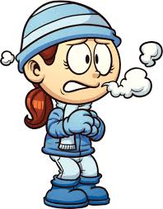
FEVRIER 2019
February 2019
lundi monday | mardi tuesday | mercredi wednesday | jeudi thursday | vendredi friday | samedi saturday | dimanche sunday
 |  |  |  | 1 | 2 | 3
4 | 5 | 6 | 7 | 8 | 9 | 10
11 | 12 | 13 | 14 | 15 | 16 | 17
18 | 19 | 20 | 21 | 22 | 23 | 24
25 | 26 | 27 | 28
Chandeleur
St Valentin

Slide 7
MARS 2019
March 2019
lundi monday | mardi tuesday | mercredi wednesday | jeudi thursday | vendredi friday | samedi saturday | dimanche sunday
 |  |  |  | 1 | 2 | 3
4 | 5 | 6 | 7 | 8 | 9 | 10
11 | 12 | 13 | 14 | 15 | 16 | 17
18 | 19 | 20 | 21 | 22 | 23 | 24
25 | 26 | 27 | 28 | 29 | 30 | 31
Mardi gras
Printemps

Slide 8
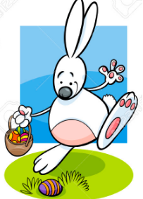
AVRIL 2019
April 2019
lundi monday | mardi tuesday | mercredi wednesday | jeudi thursday | vendredi friday | samedi saturday | dimanche sunday
1 | 2 | 3 | 4 | 5 | 6 | 7
8 | 9 | 10 | 11 | 12 | 13 | 14
15 | 16 | 17 | 18 | 19 | 20 | 21
22 | 23 | 24 | 25 | 26 | 27 | 28
29 | 30
Pâques

Slide 9
MAI 2019
May 2019
lundi monday | mardi tuesday | mercredi wednesday | jeudi thursday | vendredi friday | samedi saturday | dimanche sunday
 |  | 1 | 2 | 3 | 4 | 5
6 | 7 | 8 | 9 | 10 | 11 | 12
13 | 14 | 15 | 16 | 17 | 18 | 19
20 | 21 | 22 | 23 | 24 | 25 | 26
27 | 28 | 29 | 30 | 31
Victoire 1945
Fête des mères
Ascension

Slide 10
JUIN 2019
June 2019
lundi monday | mardi tuesday | mercredi wednesday | jeudi thursday | vendredi friday | samedi saturday | dimanche sunday
 |  |  |  |  | 1 | 2
3 | 4 | 5 | 6 | 7 | 8 | 9
10 | 11 | 12 | 13 | 14 | 15 | 16
17 | 18 | 19 | 20 | 21 | 22 | 23
24 | 25 | 26 | 27 | 28 | 29 | 30
31
Pentecôte
Fête des pères
Eté

Slide 11
JUILLET 2019
July 2019
lundi monday | mardi tuesday | mercredi wednesday | jeudi thursday | vendredi friday | samedi saturday | dimanche sunday
1 | 2 | 3 | 4 | 5 | 6 | 7
8 | 9 | 10 | 11 | 12 | 13 | 14
15 | 16 | 17 | 18 | 19 | 20 | 21
22 | 23 | 24 | 25 | 26 | 27 | 28
29 | 30 | 31
Fête nationale

Slide 12
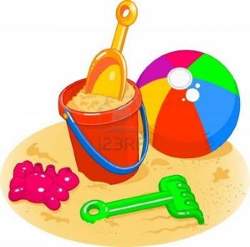
AOUT 2019
August 2019
lundi monday | mardi tuesday | mercredi wednesday | jeudi thursday | vendredi friday | samedi saturday | dimanche sunday
 |  |  | 1 | 2 | 3 | 4
5 | 6 | 7 | 8 | 9 | 10 | 11
12 | 13 | 14 | 15 | 16 | 17 | 18
19 | 20 | 21 | 22 | 23 | 24 | 25
26 | 27 | 28 | 29 | 30 | 31

