Slide 1
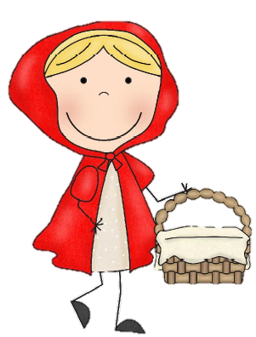
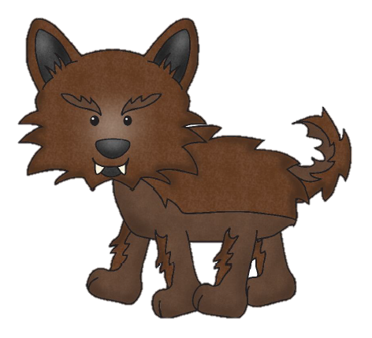
Little red ridding hood

Slide 2
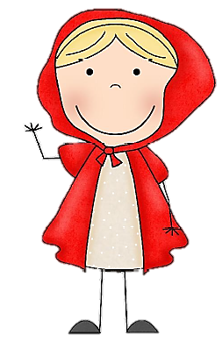
Little red ridding hood
The wolf

Slide 3
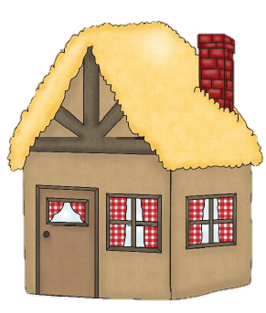
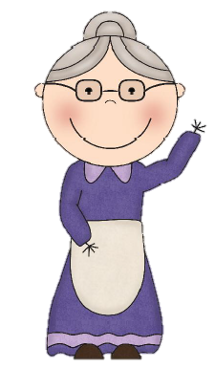
Grandma
the house

Slide 4
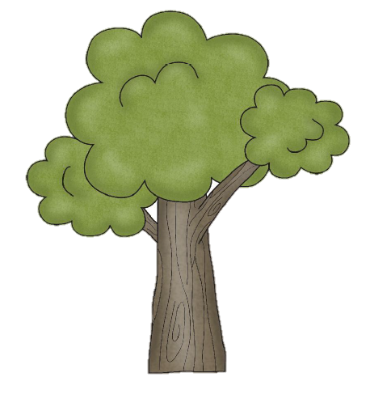
the woods
flowers

Slide 5
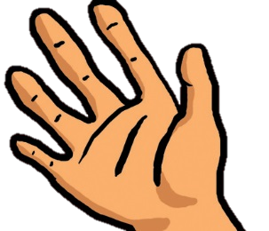
eyes
hand
ear
nose

Slide 6
Little red ridding hood
Once upon a time…

Slide 7
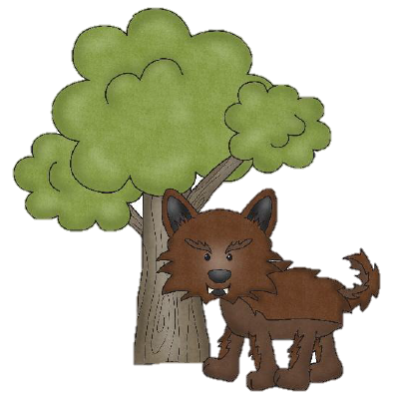
Who are you ?
Little red Riding Hood.

Slide 8
What are you doing ?
Picking flowers in the woods.

Slide 9
When did you get here ?
Ten minutes ago.

Slide 10
Where are you going ?
To my grandma’s abode.

Slide 11
Wolf knocks on the door.

Slide 12
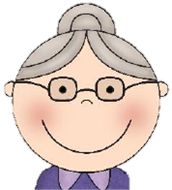
Who is it ?
It’s me, Little red Riding Hood.
Come in, come in, my darling ?

Slide 13
The wolf comes in, eats the Grandma ….

Slide 14
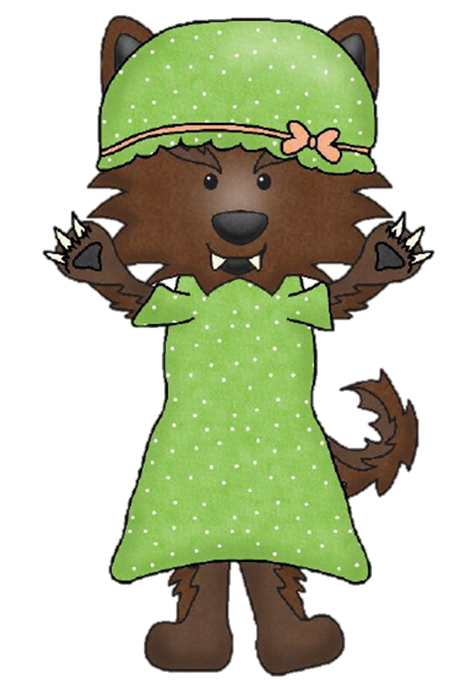
… puts on her clothes …

Slide 15
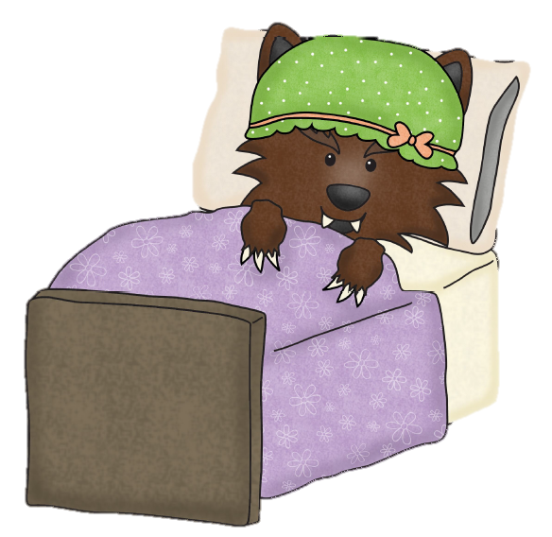
… gets into her bed and waits for Little red Riding Hood to arrive.

Slide 16
She gets to Grandma’s house and lets herself in ...

Slide 17
... turns around and notices her Grandma.

Slide 18
But Grandma, what big hands you have !
All the better to hold you with.

Slide 19
But Grandma, what big ears you have !
All the better to hear you with.

Slide 20
But Grandma, what big nose you have !
All the better to smell you with.

Slide 21
But Grandma, what big eyes you have !
All the better to see you with.

Slide 22
But Grandma, what big teeth you have !
All the better to eat you with…

Slide 23
You might want to guess how this story ends !!!

