Slide 1
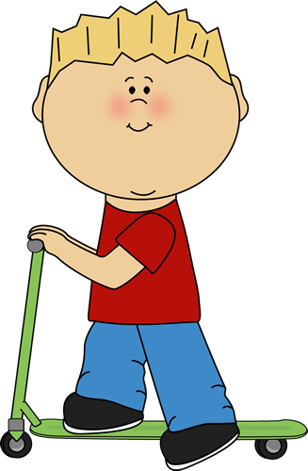
AARON | BASILE
CLÉMENCE | DAYNA
DRISS | ELLIOT

Slide 2
BASILE | AARON
DAYNA | CLÉMENCE
ELLIOT | DRISS
B
A
D
C
E
D

