Slide 1
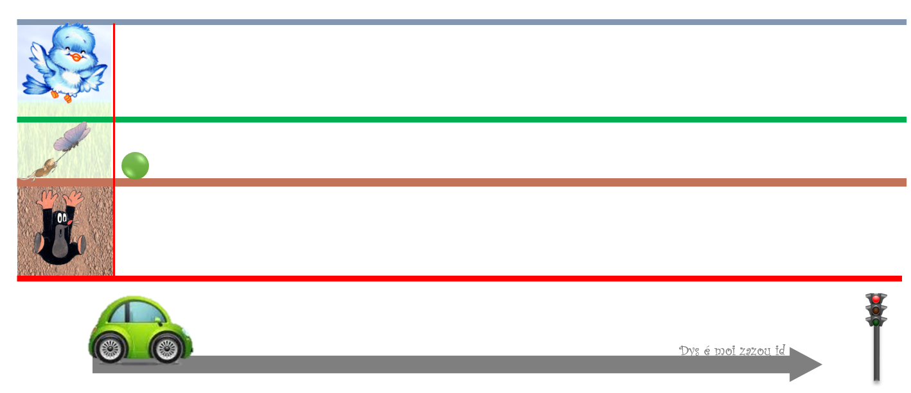
Yassine
Yassine

