Slide 1
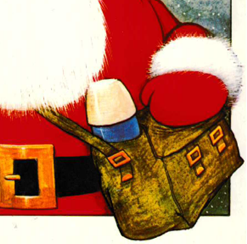
Look !
Father Christmas is going to work

Slide 2
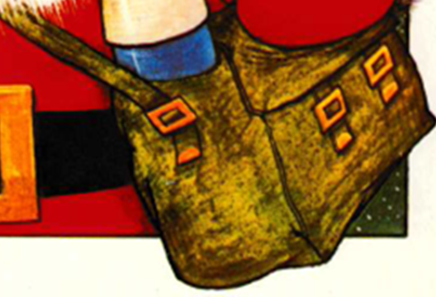
Sandwiches
Shoulder bag
Thermos

Slide 3
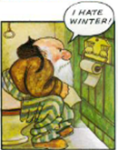
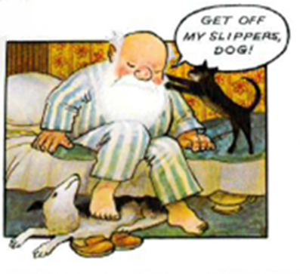
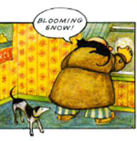
Santa is an ordinary man ...
Cares about the weather ...
Goes to the loo (toilet) and grumbles ...
He puts on slippers ...

Slide 4
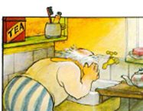
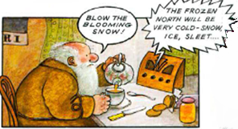
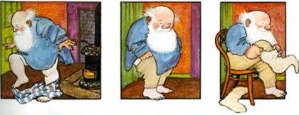
Has breakfast and listens to the radio ...
Has a wash ...
gets dressed ...

Slide 5
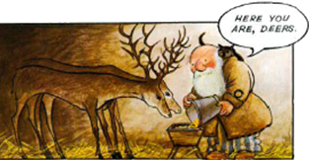
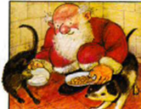
... feeds his pets.
Reindeer
Cat and dog

Slide 6
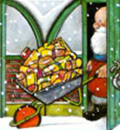
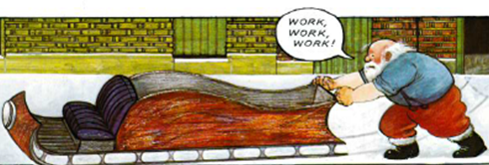
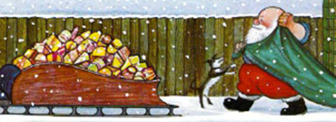
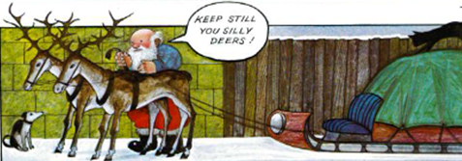
His job is to deliver presents to people in the world ...
The sleigh
The presents
Covering the presents
Tying the reindeer

Slide 7
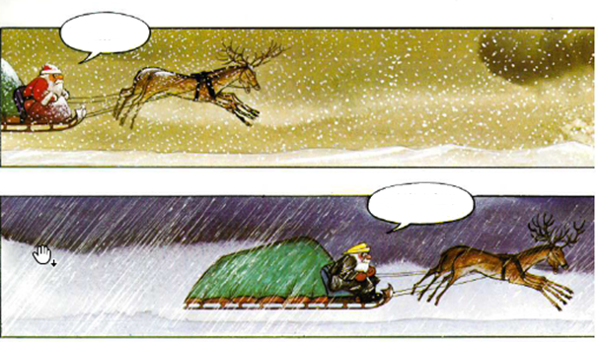
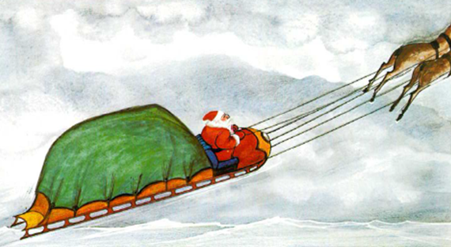
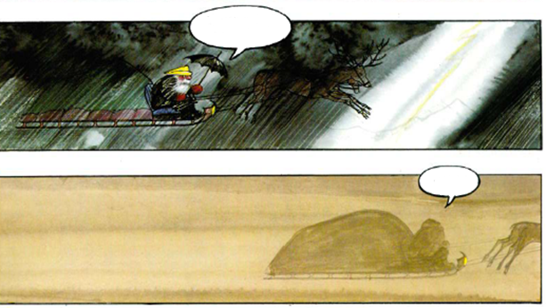
snow
rain
He goes through the air ...
storm
... And braves the weather : Can you tell the weather ?
Fog

Slide 8
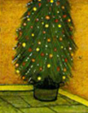
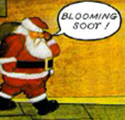
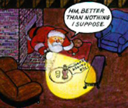
Father Christmas puts the presents under the Christmas tree
Sometimes, he finds a small present left for him ...

Slide 9
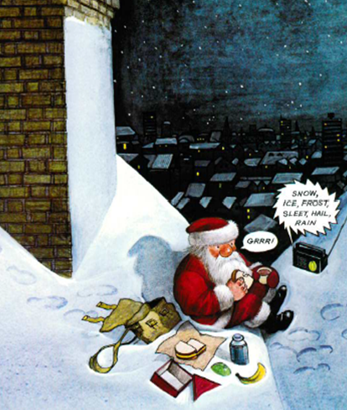
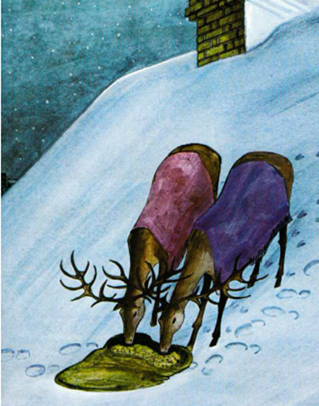
Time for a picnic !
What can you see in this picture ?

Slide 10
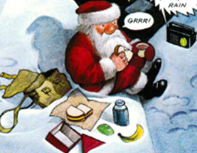
Radio
Shoulder bag
Thermos
Sandwiches
Banana
Apple

Slide 11
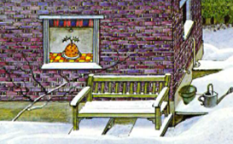
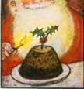
What can you see through that window ?
Yes ! A christmas Pudding !

Slide 12
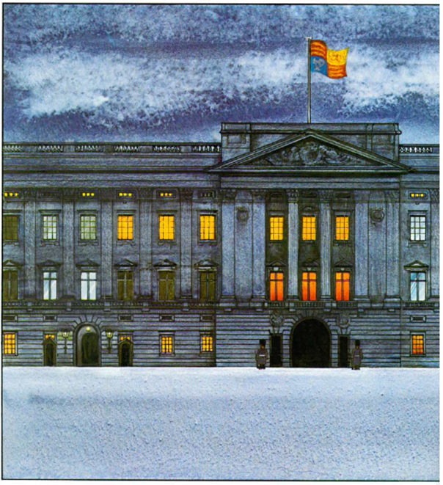
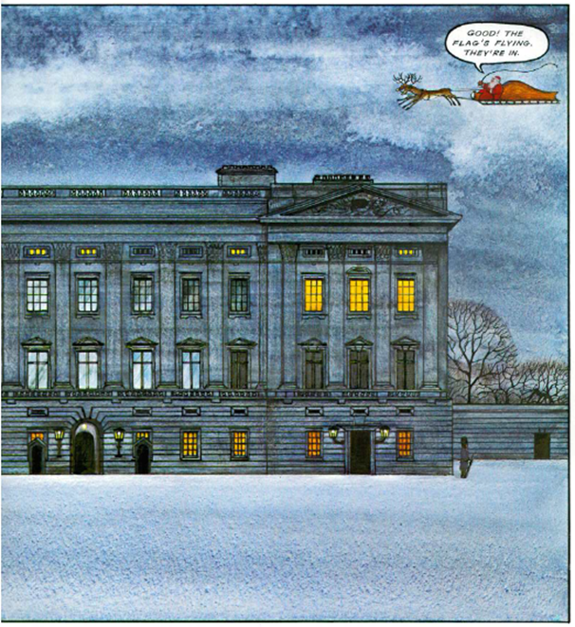
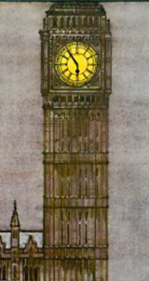
Do you know these monuments ?
Where can you find them ?
Big Ben
Buckingham Palace
London

Slide 13
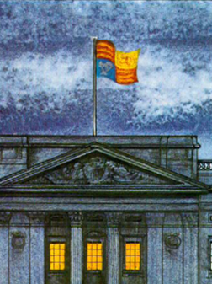
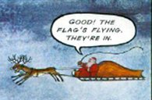
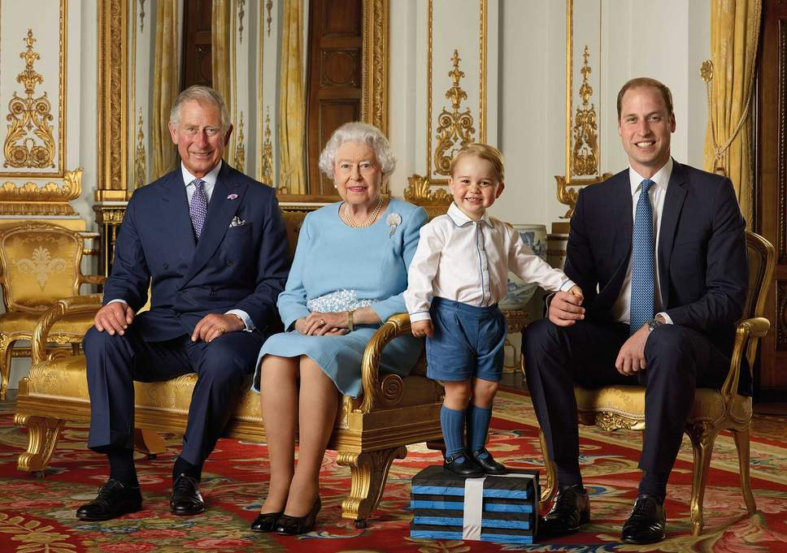
When the flag is flying, that means the royal family is in.

Slide 14
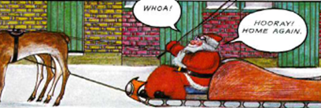
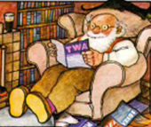
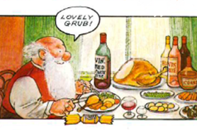
Back home !
Time for a rest ...
... and a good Christmas meal !
Hey, what’s that ?

Slide 15
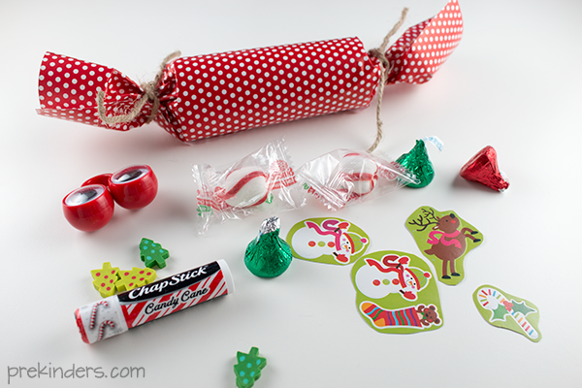
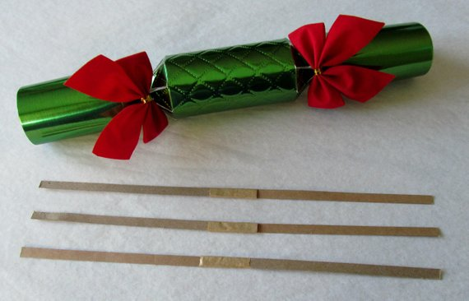
Cracker
Small presents
Snaps bangers (snaps)

Slide 16
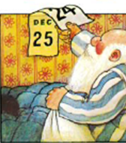
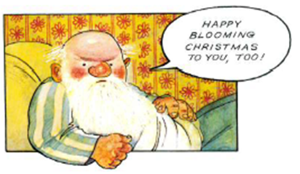
Now, let’s go to bed ! Xmas eve is over !
Merry Christmas to all !

