Slide 1
La ville
Découverte du monde – Anglais
⇨ Structures

Slide 2
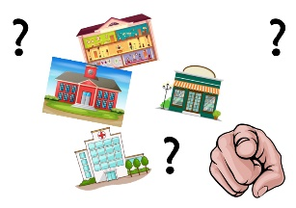
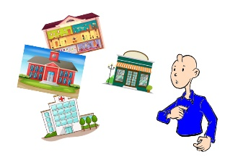
Where are you going ?
I’m going to...

Slide 3
Where are you going ?
I’m going to the hospital.

Slide 4
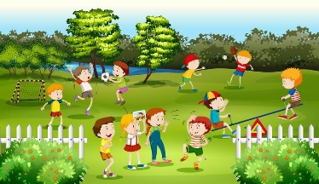
Where are you going ?
I’m going to the park.

Slide 5
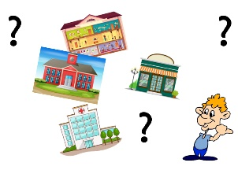
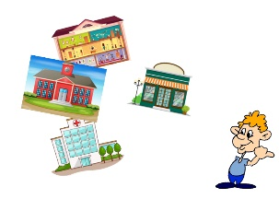
Where is he going ?
Where is she going ?
He’s going to...
She’s going to...

Slide 6
Where is he going ?
He’s going to the store.

Slide 7
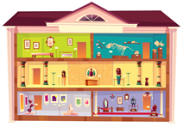
Where is she going ?
She’s going to the museum.

