Slide 1
Les parties du corps
Découverte du monde – Anglais
⇨ Let’s sing a song

Slide 2
Try to find words you know in the song.

Slide 3
Listen to the song again, stick the pictures and write the words.

Slide 4
Let’s correct.

Slide 5
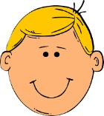
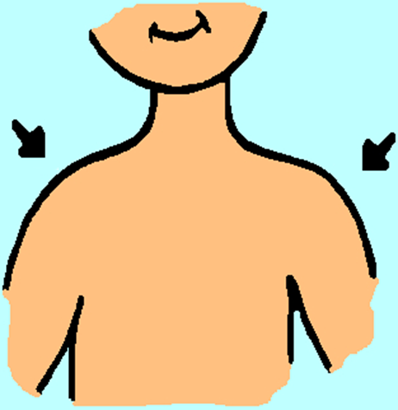
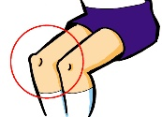
head
shoulders
knees
toes
knees
toes

Slide 6
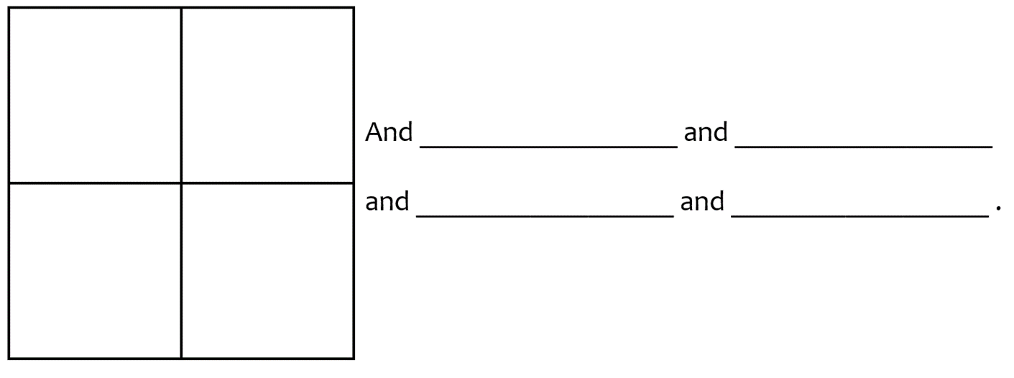
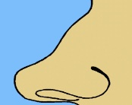
eyes
ears
mouth
nose

Slide 7
head
shoulders
knees
toes
knees
toes

Slide 9
Now, let’s sing and dance !

