Slide 1

Halloween
Découverte du monde – Anglais
⇨ Halloween colours

Slide 2

Let’s listen to a song !

Slide 3
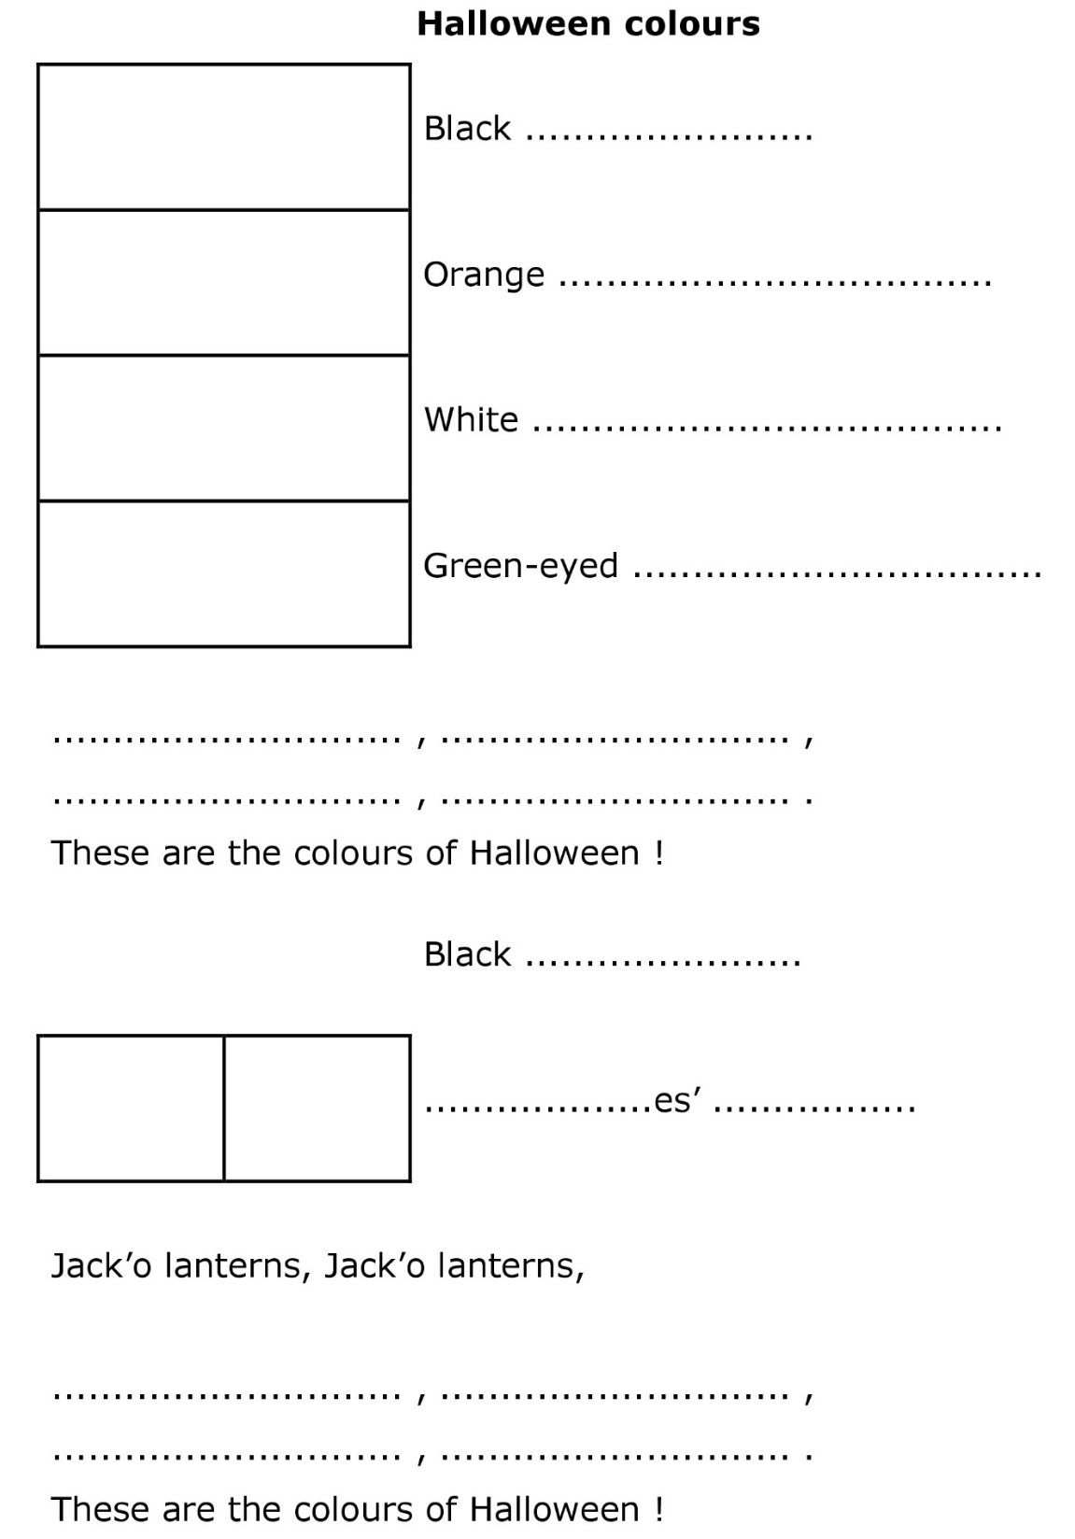

Listen to the song and stick the pictures.

Slide 4
Listen to the song again and write the words.

Slide 5
Let’s correct the exercise.

Slide 6

cat
pumpkin
ghost
monster
Black
orange
white
green

Slide 7
cats
whitch
hats
Black
orange
white
green

Slide 8

Now, let’s sing the song !

