Slide 1
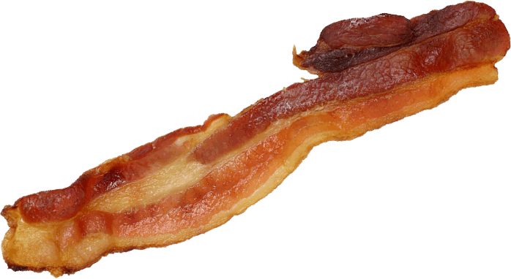
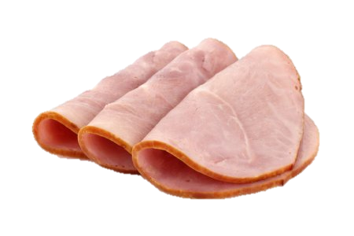
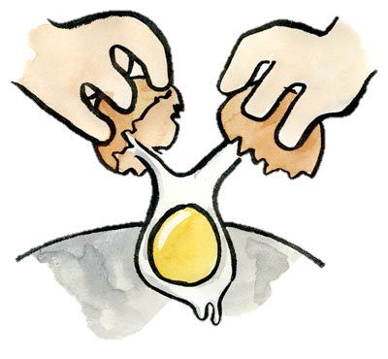
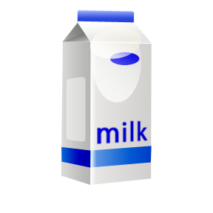


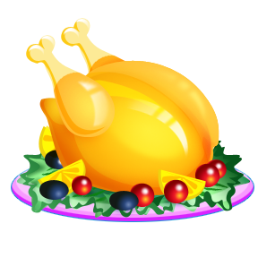
Food
Today is .........................................................................
★ Vocabulary
bread
ham
bacon
butter
milk
coffee
eggs
tea
cheese
chicken
Vegetables
potatoes
beans

Slide 2
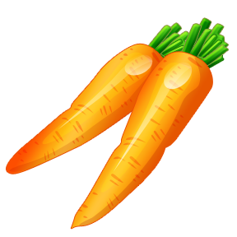
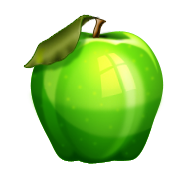
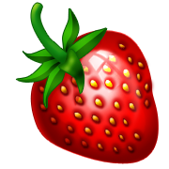

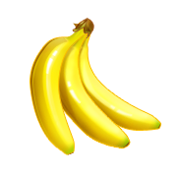
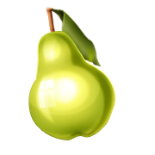


carrots
spinach
peas
Fruits
a strawberry
- strawberries
an apple
a banana
a pear
a cherry
- cherries
a lemon
an orange
★ Sentences
Do you like bacon ?
Yes I do.
Do you like eggs ?
No, I don’t (= do not).
What’s your favorite food ?
My favorite food is ham.
Do you love apples ?
Yes I do.
Do you love beans ?
No, I don’t (= do not).
Do you prefer spinach ?
Yes I do.
Do you prefer cherries ?
No, I don’t (= do not).

