Slide 1
PLACER DES NOMBRES SUR UNE LIGNE NUMÉRIQUE
Repérer une position sur une ligne numérique

Slide 2
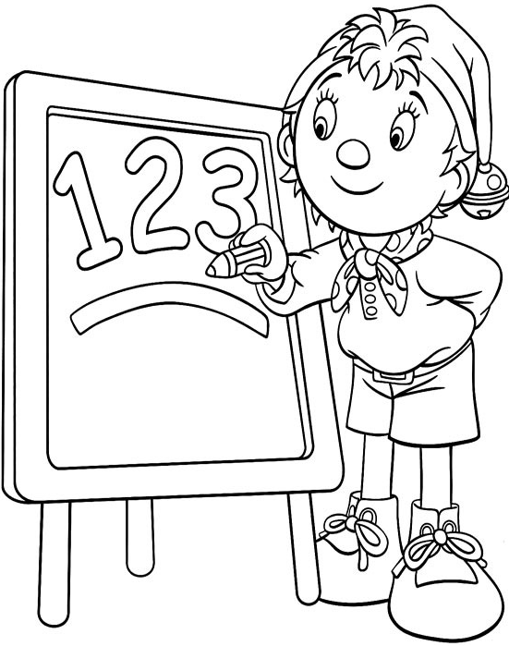
36
0 | 10 | 20 | 30 | 40 | 50 | 60 | 70 | 80 | 90 | 100

Slide 3
62
0 | 10 | 20 | 30 | 40 | 50 | 60 | 70 | 80 | 90 | 100

Slide 4
85
0 | 10 | 20 | 30 | 40 | 50 | 60 | 70 | 80 | 90 | 100

Slide 5
74
0 | 10 | 20 | 30 | 40 | 50 | 60 | 70 | 80 | 90 | 100
Combien y a-t-il de barres entre chaque graduation de dizaines ?
Par exemple, entre 30 et 40 ?
Cela délimite combien d’espaces ?

Slide 6
97
0 | 10 | 20 | 30 | 40 | 50 | 60 | 70 | 80 | 90 | 100

Slide 7
6
0 | 10 | 20 | 30 | 40 | 50 | 60 | 70 | 80 | 90 | 100

Slide 8
69
0 | 10 | 20 | 30 | 40 | 50 | 60 | 70 | 80 | 90 | 100

Slide 9
35

Slide 10
68

Slide 11
51

Slide 12
92

Slide 13
49

Slide 14
77

Slide 15
42
0 | 10 |  | 30 |  | 50 |  | 70 |  | 90

Slide 16
66
0 | 10 |  | 30 |  | 50 |  | 70 |  | 90

Slide 17
81
0 | 10 |  | 30 |  | 50 |  | 70 |  | 90

Slide 18
80
0 | 10 |  |  |  |  |  |  |  |  | 100

Slide 19
30
0 | 10 |  |  |  |  |  |  |  |  | 100

Slide 20
58
0 | 10 |  |  |  |  |  |  |  |  | 100

Slide 21
83
0 | 10 |  |  |  |  |  |  |  |  | 100

Slide 22
79
0 | 10 |  |  |  |  |  |  |  |  | 100

Slide 23
44
0 | 10 |  |  |  |  |  |  |  |  | 100

Slide 24
61
0 | 10 |  |  |  |  |  |  |  |  | 100

Slide 25
38
0 |  | 20 |  | 40 |  | 60 |  | 80 |  | 100 |  | 120

Slide 26
72
0 |  | 20 |  | 40 |  | 60 |  | 80 |  | 100 |  | 120

Slide 27
35
0 | 10 | 20 | 30 | 40 | 50 | 60 | 70 | 80 | 90 | 100 | 110 | 120
0 |  | 20 |  | 40 |  | 60 |  | 80 |  | 100 |  | 120

Slide 28
71
0 | 10 | 20 | 30 | 40 | 50 | 60 | 70 | 80 | 90 | 100 | 110 | 120
0 |  | 20 |  | 40 |  | 60 |  | 80 |  | 100 |  | 120

Slide 29
99
0 | 10 | 20 | 30 | 40 | 50 | 60 | 70 | 80 | 90 | 100 | 110 | 120
0 |  | 20 |  | 40 |  | 60 |  | 80 |  | 100 |  | 120

Slide 30
56
0 | 10 | 20 | 30 | 40 | 50 | 60 | 70 | 80 | 90 | 100 | 110 | 120
0 |  | 20 |  | 40 |  | 60 |  | 80 |  | 100 |  | 120

Slide 31
40
60
80

Slide 32
20
30
60

Slide 33
50
80
90

Slide 34
60
80
100

Slide 35
30
35
40
31 | 32 | 33 | 34 | 35 | 36 | 37 | 38 | 39

Slide 36
80
88
90
81 | 82 | 83 | 84 | 85 | 86 | 87 | 88 | 89

Slide 37
70
72
80
71 | 72 | 73 | 74 | 75 | 76 | 77 | 78 | 79

Slide 38
70
85
90
71 | 72 | 73 | 74 | 75 | 76 | 77 | 78 | 79
80 | 81 | 82 | 83 | 84 | 85 | 86 | 87 | 88 | 89

Slide 39
60
65
80
71 | 72 | 73 | 74 | 75 | 76 | 77 | 78 | 79
80 | 81 | 82 | 83 | 84 | 85 | 86 | 87 | 88 | 89

Slide 40
60
75
90
70
80
61 | 62 | 63 | 64 | 65 | 66 | 67 | 68 | 69
71 | 72 | 73 | 74 | 75 | 76 | 77 | 78 | 79
81 | 82 | 83 | 84 | 85 | 86 | 87 | 88 | 89

Slide 41
50
65
80
60
70
51 | 52 | 53 | 54 | 55 | 56 | 57 | 58 | 59
61 | 62 | 63 | 64 | 65 | 66 | 67 | 68 | 69
71 | 72 | 73 | 74 | 75 | 76 | 77 | 78 | 79

Slide 42
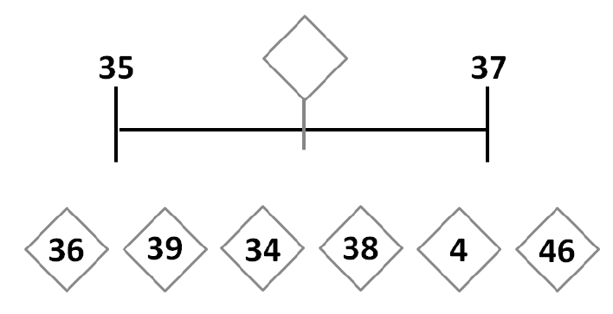
36

Slide 43
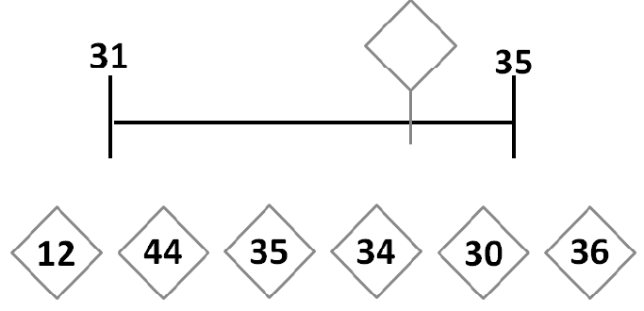
34

Slide 44
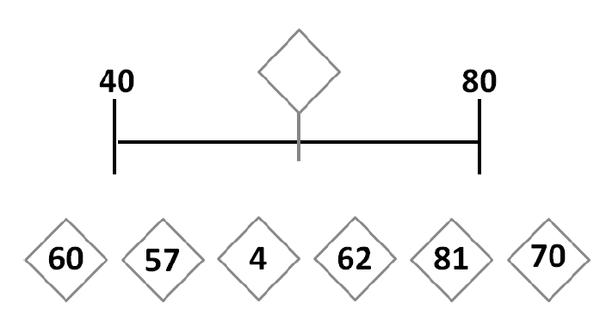
60
40 | 50 | 60 | 70 | 80

Slide 45
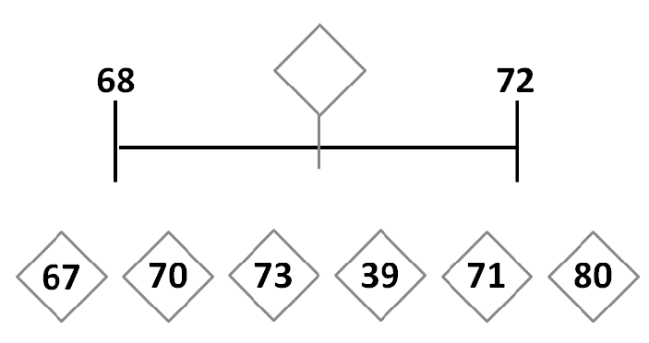
70
69 | 70 | 71

Slide 46
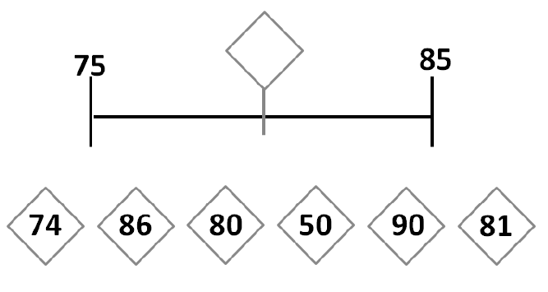
80

Slide 47
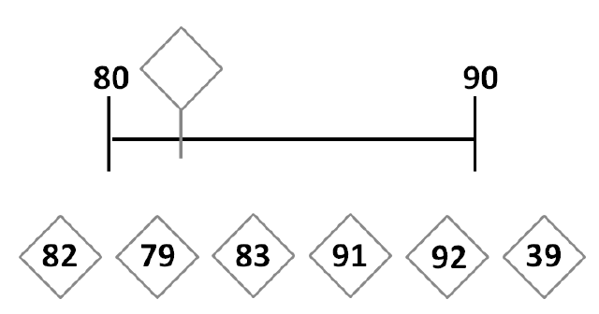
82

Slide 48
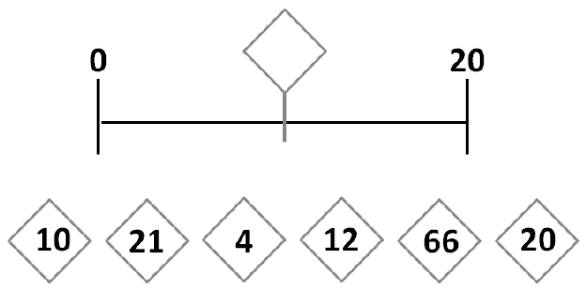
10

Slide 49
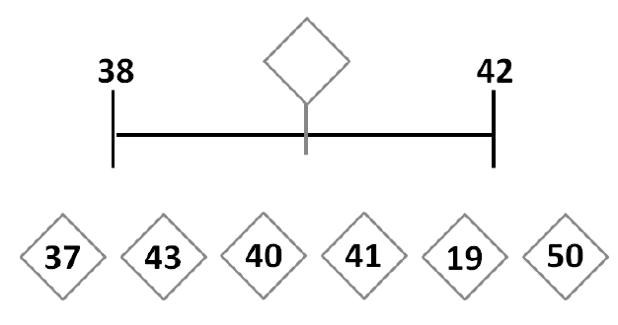
40
39 | 40 | 41

Slide 50
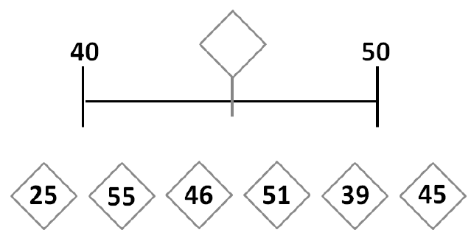
45
40 | 45 | 50

Slide 51
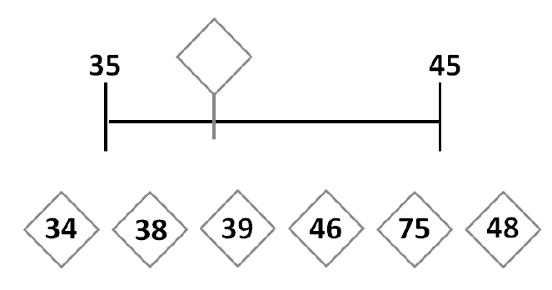
38
36 | 37 | 38 | 39 | 40 | 41 | 42 | 43 | 44

Slide 52
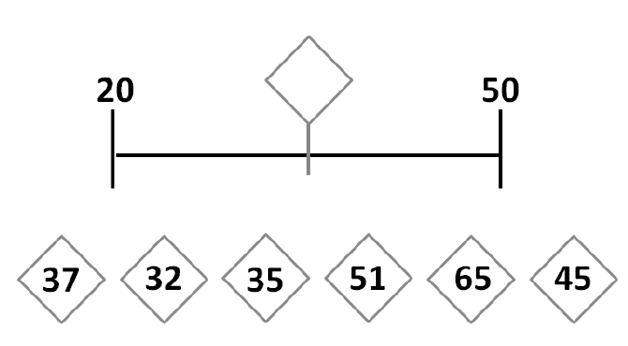
35
0 | 10 | 20 | 30 | 40 | 50 | 60

Slide 53
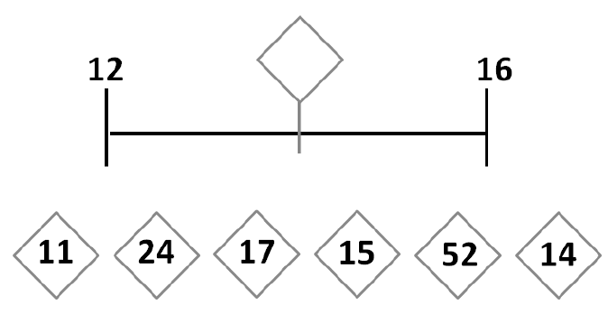
14
13 | 14 | 15

Slide 54
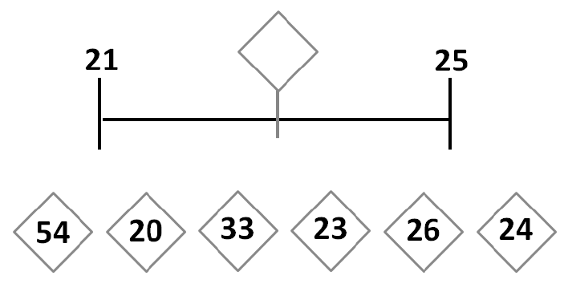
23
22 | 23 | 24

Slide 55
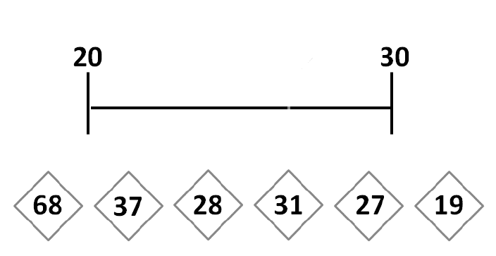
27
21 | 22 | 23 | 24 | 25 | 26 | 27 | 28 | 29

Slide 56
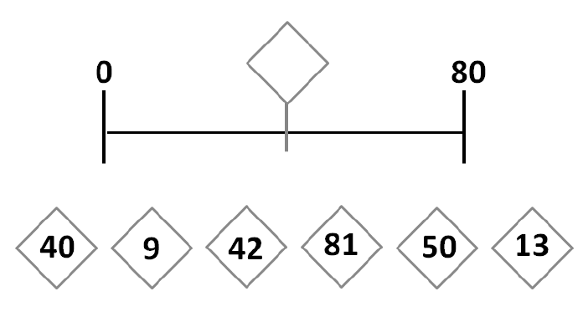
40
0 | 10 | 20 | 30 | 40 | 50 | 60 | 70 | 80 | 90 | 100

Slide 57
PLACER DES NOMBRES SUR UNE LIGNE NUMÉRIQUE
Changer d’unité de graduation

Slide 58
24
0 |  |  |  |  | 10 |  |  |  |  | 20 |  |  |  |  | 30 |  |  |  |  | 40
0 | 2 | 4 | 6 | 8 | 10 | 12 | 14 | 16 | 18 | 20 | 22 | 24 | 26 | 28 | 30 | 32 | 34 | 36 | 38 | 40 | 42

Slide 59
36
0 |  |  |  |  | 10 |  |  |  |  | 20 |  |  |  |  | 30 |  |  |  |  | 40
0 | 2 | 4 | 6 | 8 | 10 | 12 | 14 | 16 | 18 | 20 | 22 | 24 | 26 | 28 | 30 | 32 | 34 | 36 | 38 | 40 | 42

Slide 60
16
0 |  |  |  |  | 10 |  |  |  |  | 20 |  |  |  |  | 30 |  |  |  |  | 40
0 | 2 | 4 | 6 | 8 | 10 | 12 | 14 | 16 | 18 | 20 | 22 | 24 | 26 | 28 | 30 | 32 | 34 | 36 | 38 | 40 | 42

Slide 61
42
0 |  |  |  |  | 10 |  |  |  |  | 20 |  |  |  |  | 30 |  |  |  |  | 40
0 | 2 | 4 | 6 | 8 | 10 | 12 | 14 | 16 | 18 | 20 | 22 | 24 | 26 | 28 | 30 | 32 | 34 | 36 | 38 | 40 | 42

Slide 62
36
 |  | 30 |  |  |  |  | 40 |  |  |  |  | 50 |  |  |  |  | 60
 | 28 | 30 | 32 | 34 | 36 | 38 | 40 | 42 | 44 | 46 | 48 | 50 | 52 | 54 | 56 | 58 | 60 | 62 | 64 | 66 | 68

Slide 63
58
 |  | 30 |  |  |  |  | 40 |  |  |  |  | 50 |  |  |  |  | 60
 | 28 | 30 | 32 | 34 | 36 | 38 | 40 | 42 | 44 | 46 | 48 | 50 | 52 | 54 | 56 | 58 | 60 | 62 | 64 | 66 | 68

Slide 64
44
 |  | 30 |  |  |  |  | 40 |  |  |  |  | 50 |  |  |  |  | 60
 | 28 | 30 | 32 | 34 | 36 | 38 | 40 | 42 | 44 | 46 | 48 | 50 | 52 | 54 | 56 | 58 | 60 | 62 | 64 | 66 | 68

Slide 65
62
 |  | 30 |  |  |  |  | 40 |  |  |  |  | 50 |  |  |  |  | 60
 | 28 | 30 | 32 | 34 | 36 | 38 | 40 | 42 | 44 | 46 | 48 | 50 | 52 | 54 | 56 | 58 | 60 | 62 | 64 | 66 | 68

Slide 66
84
 | 66 | 68 | 70 | 72 | 74 | 76 | 78 | 80 | 82 | 84 | 86 | 88 | 90 | 92 | 94 | 96 | 98 | 100 | 102 | 104 | 106
 |  |  | 70 |  |  |  |  | 80 |  |  |  |  | 90 |  |  |  |  | 100

Slide 67
76
 | 66 | 68 | 70 | 72 | 74 | 76 | 78 | 80 | 82 | 84 | 86 | 88 | 90 | 92 | 94 | 96 | 98 | 100 | 102 | 104 | 106
 |  |  | 70 |  |  |  |  | 80 |  |  |  |  | 90 |  |  |  |  | 100

Slide 68
98
 | 66 | 68 | 70 | 72 | 74 | 76 | 78 | 80 | 82 | 84 | 86 | 88 | 90 | 92 | 94 | 96 | 98 | 100 | 102 | 104 | 106
 |  |  | 70 |  |  |  |  | 80 |  |  |  |  | 90 |  |  |  |  | 100

Slide 69
82
 |  |  | 70 |  |  |  |  | 80 |  |  |  |  | 90 |  |  |  |  | 100
 | 66 | 68 | 70 | 72 | 74 | 76 | 78 | 80 | 82 | 84 | 86 | 88 | 90 | 92 | 94 | 96 | 98 | 100 | 102 | 104 | 106

Slide 70
96
 | 66 | 68 | 70 | 72 | 74 | 76 | 78 | 80 | 82 | 84 | 86 | 88 | 90 | 92 | 94 | 96 | 98 | 100 | 102 | 104 | 106
 |  |  | 70 |  |  |  |  | 80 |  |  |  |  | 90 |  |  |  |  | 100

Slide 71
66
 | 66 | 68 | 70 | 72 | 74 | 76 | 78 | 80 | 82 | 84 | 86 | 88 | 90 | 92 | 94 | 96 | 98 | 100 | 102 | 104 | 106
 |  |  | 70 |  |  |  |  | 80 |  |  |  |  | 90 |  |  |  |  | 100

Slide 73
0 | 10 | 20 | 30 | 40 | 50 | 60 | 70 | 80 | 90 | 100

Slide 76
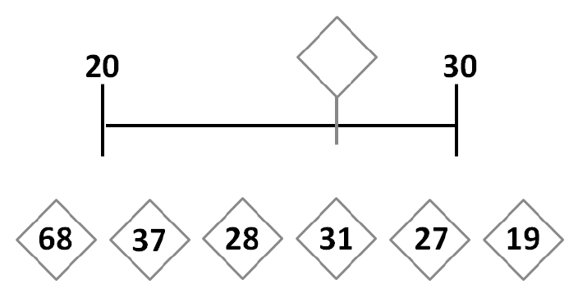
21 | 22 | 23 | 24 | 25 | 26 | 27 | 28 | 29
ERREUR DE REPRÉSENTATION

