Slide 1
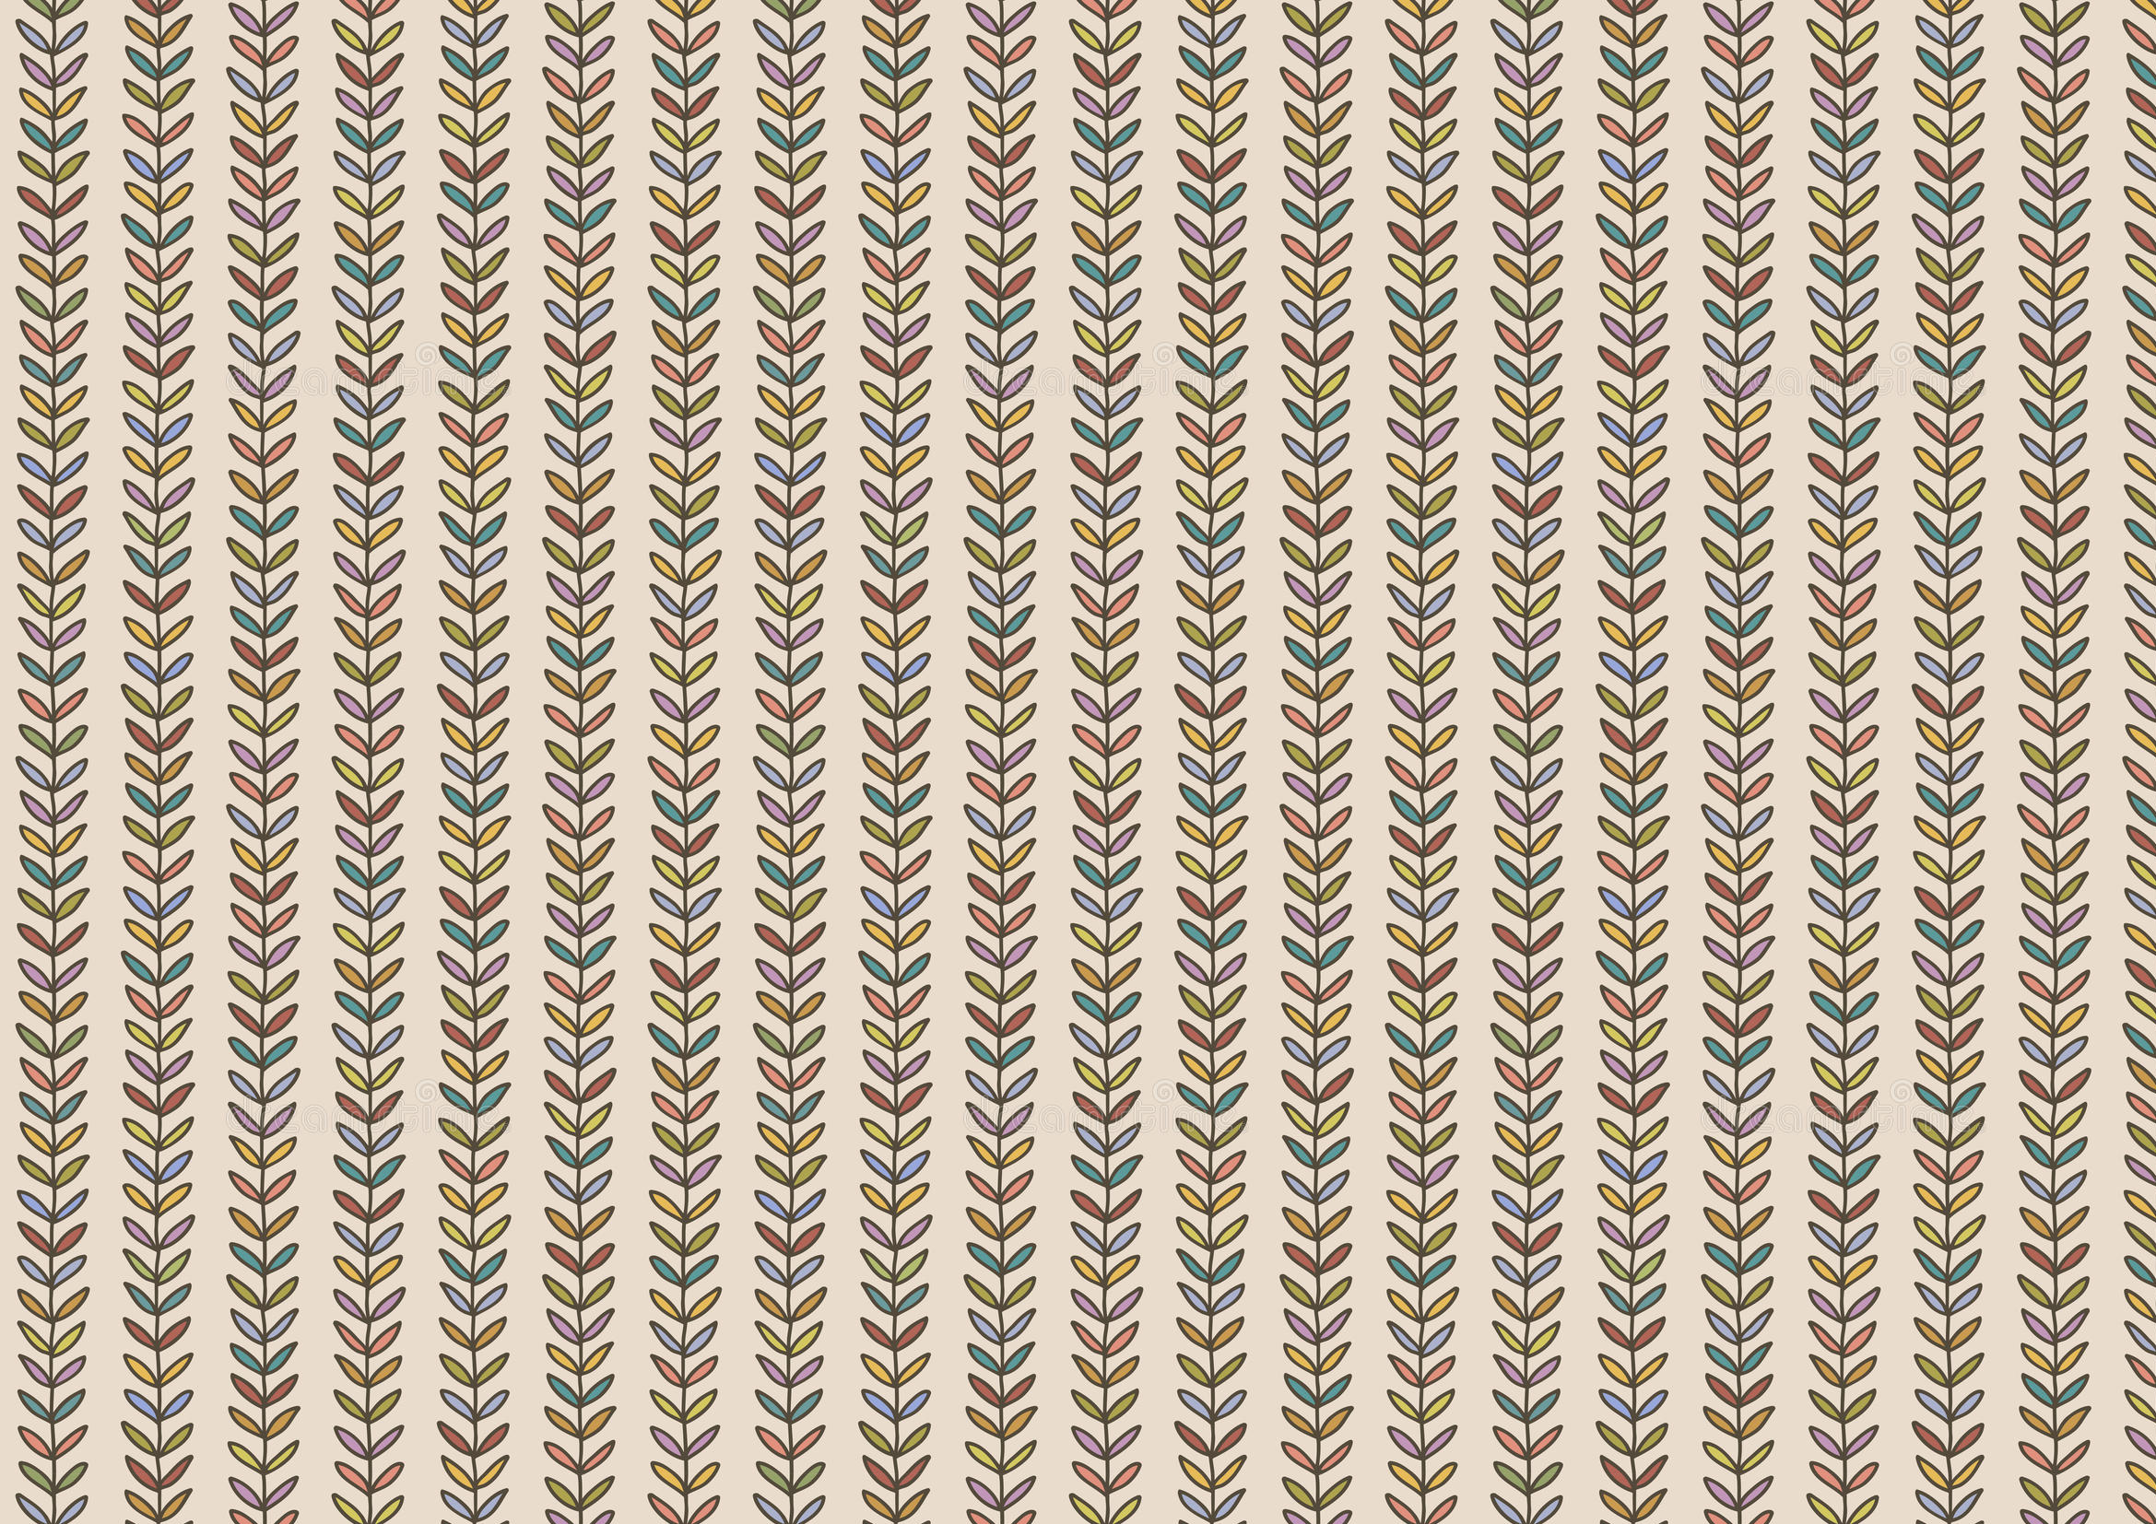
Le château des nombres
Le château des nombres
0 | 1 |  | 3 |  | 5 |  | 7 |  | 9
 |  |  |  |  |  |  | G
20 |  |  | A
30 |  |  |  |  | D
 |  |  |  |  |  |  |  |  | H
50 |  |  |  |  |  |  |  | I
60 |  | E |  |  |  |  | B
 |  |  |  |  | J
80 |  |  |  | F |  |  |  |  | C
 |  | K |  |  |  |  |  | L
0 |  | 2 |  | 4 |  | 6 |  | 8
10 |  |  |  |  |  | D
 |  |  |  |  |  |  | L
30 |  |  | E |  |  |  |  | A
 |  |  |  | I
 |  |  |  |  | K
60 |  |  |  | B |  |  | F
 |  |  |  |  |  |  |  | H
 |  | J
90 |  | C |  |  |  |  |  |  | G
Niveau 2
A
Niveau 2
B

Slide 2
Le château des nombres
Le château des nombres
0 | 1 |  | 3 |  | 5 |  | 7 |  | 9
10 |  |  |  |  |  |  |  |  | D
 |  |  |  | L |  |  |  | H
 |  |  | E
40 |  |  |  |  |  |  | C
 | K |  |  |  | G
 |  |  |  |  |  | J |  |  | F
70 |  |  |  |  | A
80 |  |  | B
 |  | I
0 |  | 2 |  | 4 |  |  |  | 8
20
50
90
0 |  | 2 |  | 4 |  |  |  | 8
20 |  | B |  |  |  | G
 |  |  |  |  | J |  |  |  | I
 |  | D
50 |  |  |  |  |  |  |  | A
 | H
 |  |  |  | E
 |  |  | L |  |  |  |  | F
90 |  |  |  | C |  |  | K
Niveau 2
C
Niveau 2
D

Slide 3
Le château des nombres
Le château des nombres
0 |  | 2 |  |  | 5 |  |  | 8
20 |  | D |  |  |  | F
30 |  |  |  |  |  |  |  | A
 |  | H |  | L
50 |  |  |  |  |  |  | G
60 |  | C
 |  |  |  | K |  |  |  | I
80 |  |  |  |  | B |  |  |  | E
 |  | J
0 | 1 |  | 3 |  |  |  | 7 | 8
10 |  |  |  |  | F |  | C
30 |  |  | A |  |  |  |  | D
 | J
 |  |  |  | L |  |  |  |  | K
60 |  | E |  |  |  | G
 |  |  |  |  |  |  | I
 |  |  | H
90 |  |  |  |  |  |  |  | B
Niveau 2
E
Niveau 2
F

Slide 4
Le château des nombres
Le château des nombres
0 | 1 |  | 3 |  | 5 |  | 7 |  | 9
 |  |  | G
20 |  |  |  |  |  |  | C
30 |  |  |  |  | D
 |  |  |  |  |  | K |  |  | I
50 |  |  |  | E
60 |  |  | B |  |  |  |  | F
 |  |  |  |  | H
80 |  |  |  |  |  |  |  |  | A
 |  | J |  |  |  | L
0 |  | 2 |  | 4 |  | 6 |  | 8
10 |  |  |  | C |  |  | E
 |  | G
30 |  |  |  |  |  |  |  | D
 |  |  |  |  |  | H
 |  |  | K
60 |  |  |  | A
 |  |  |  |  |  |  |  | I
 |  |  | J |  |  | L
90 |  | B |  |  |  |  |  |  | F
Niveau 2
G
Niveau 2
H

Slide 5
Le château des nombres
Le château des nombres
0 | 1 |  | 3 |  | 5 |  | 7 |  | 9
10 |  |  |  |  | B
 | G
 |  |  |  |  |  | K
40 |  | D |  |  |  |  |  | F
 |  |  |  | J
 |  | L |  |  |  |  |  |  | I
70 |  |  |  |  |  | E
80 |  |  | C |  |  |  |  |  | A
 |  |  |  |  |  |  | H
0 |  | 2 |  | 4 |  |  |  | 8
20
50
90
0 |  | 2 |  | 4 |  |  |  | 8
 |  |  |  |  |  |  |  |  | I
20 |  |  |  | B |  |  | D
 |  | G
 |  |  |  |  |  | J
50 |  | A |  |  |  |  |  |  | F
 |  |  |  |  |  |  | L
 |  |  |  | H
 | K
90 |  |  | E |  |  |  |  | C
Niveau 2
I
Niveau 2
J

Slide 6
Le château des nombres
Le château des nombres
0 |  | 2 |  |  | 5 |  |  | 8
 |  |  | I |  |  |  | K
20 |  |  |  |  |  |  |  | B
30 |  | C
 |  |  |  | H
50 |  |  |  |  | A
60 |  | E
 |  |  | J |  |  |  |  | F
80 |  |  |  |  |  |  |  |  | D
 | L |  |  |  | G
0 | 1 |  | 3 |  |  |  | 7 | 8
10 |  |  |  |  |  | H
 | E
30 |  |  | C
 |  |  |  |  | L |  | F
 |  | I |  |  |  |  |  | G
60 |  |  | A
 |  |  |  |  |  |  |  |  | J
 |  |  |  | K
90 | B |  |  |  |  |  |  | D
Niveau 2
K
Niveau 2
L

