Slide 1
Location prepositions
Where is Spot ?

Slide 2
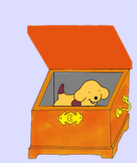
WHERE IS SPOT ?
Spot is in the box.

Slide 3
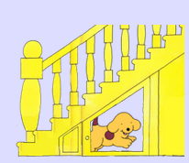
WHERE IS SPOT ?
Spot is under the stairs.

Slide 4
WHERE IS SPOT ?
Spot is on the bed.

Slide 5
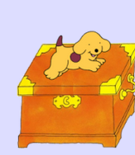
WHERE IS SPOT ?
Spot jumps over the box.

Slide 6
WHERE IS SPOT ?
Spot is in front of the wardrobe.

Slide 7
WHERE IS SPOT ?
Spot is next to the basket.

Slide 8
WHERE IS SPOT ?
Spot is between two baskets.

Slide 9
WHERE IS SPOT ?
Spot is under the rug (the carpet).

Slide 10
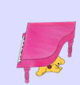
WHERE IS SPOT ?
Spot is under the piano.

Slide 11
WHERE IS SPOT ?
Spot is next to the clock.

Slide 12
WHERE IS SPOT ?
Spot is behind the wardrobe.

Slide 13
WHERE IS SPOT ?
Spot is on the stairs.

Slide 14
WHERE IS SPOT ?
Spot is behind the clock.

Slide 15
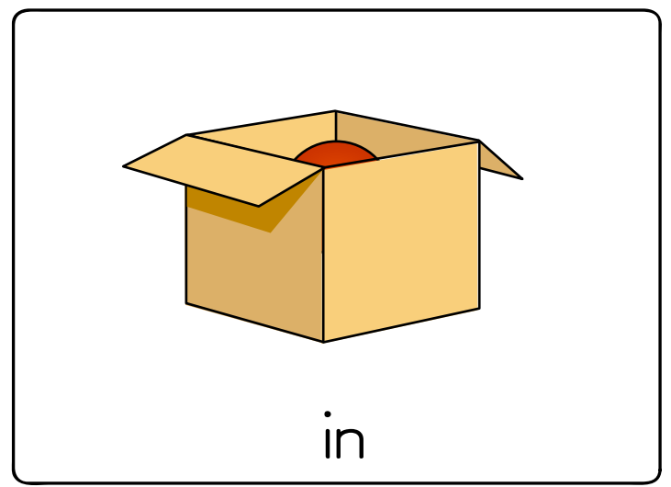

Slide 16
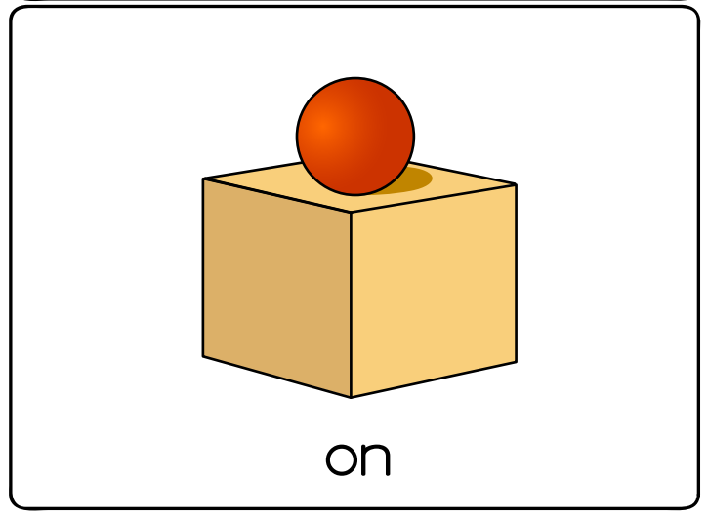

Slide 18
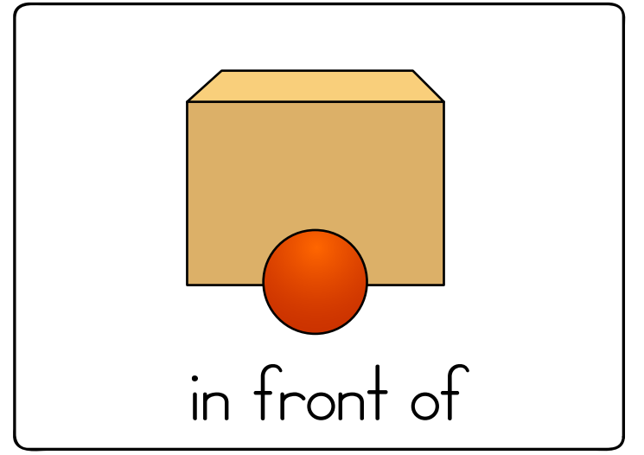

Slide 19
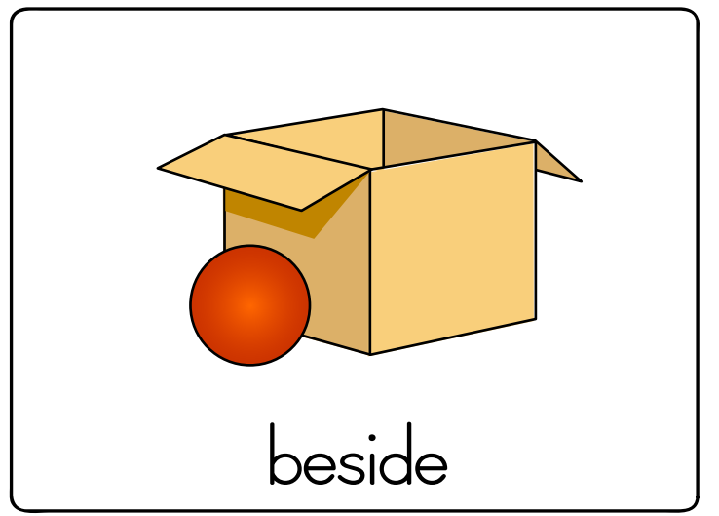

Slide 20
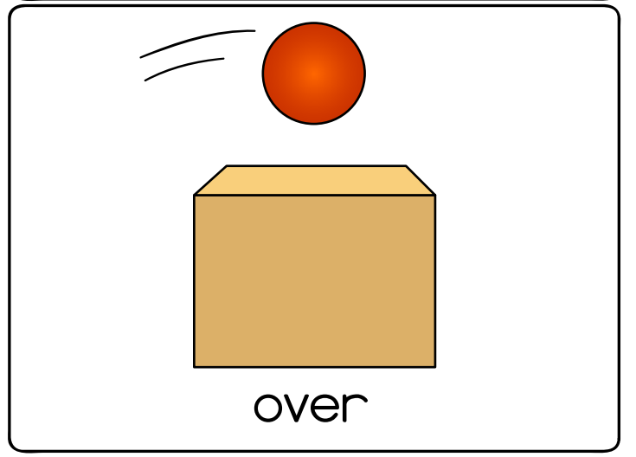

Slide 21
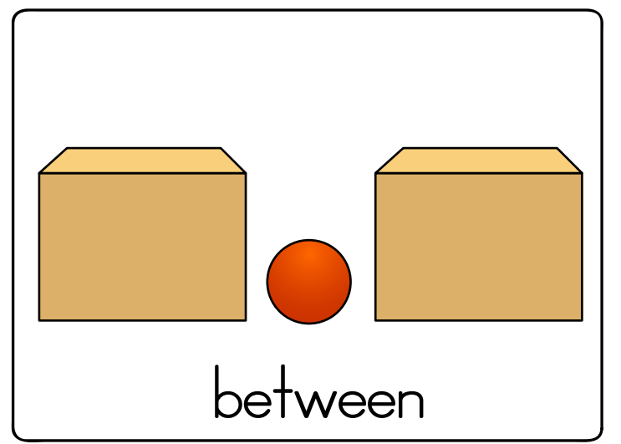

Slide 22
