Slide 1
PANCAKE RECIPE By Mélody and Chloé

Slide 2
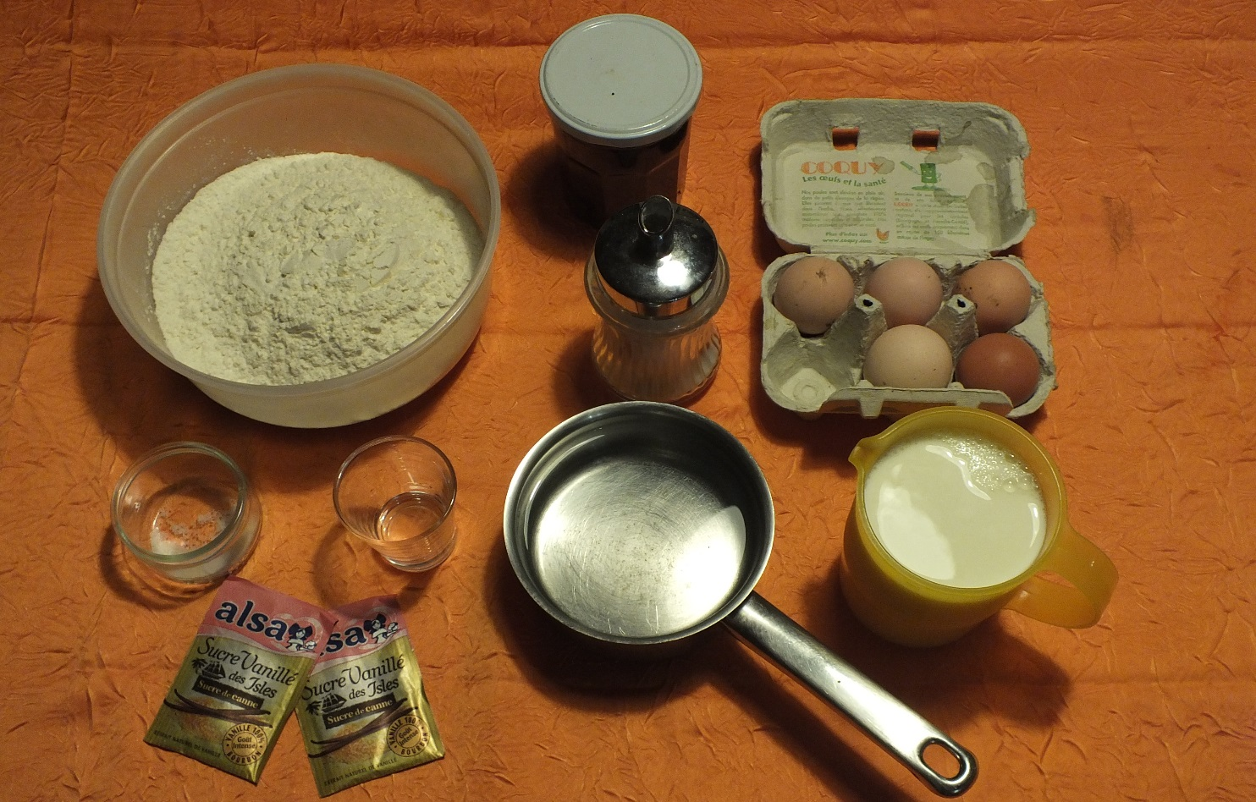
ingredients
- 500g flour - 5 eggs - 2 packets of vanilla sugar - 1 teaspoon of rum - 1 pinch of salt - 1 small pot of warm water - 500 ml of milk - Jam, castor sugar

Slide 3
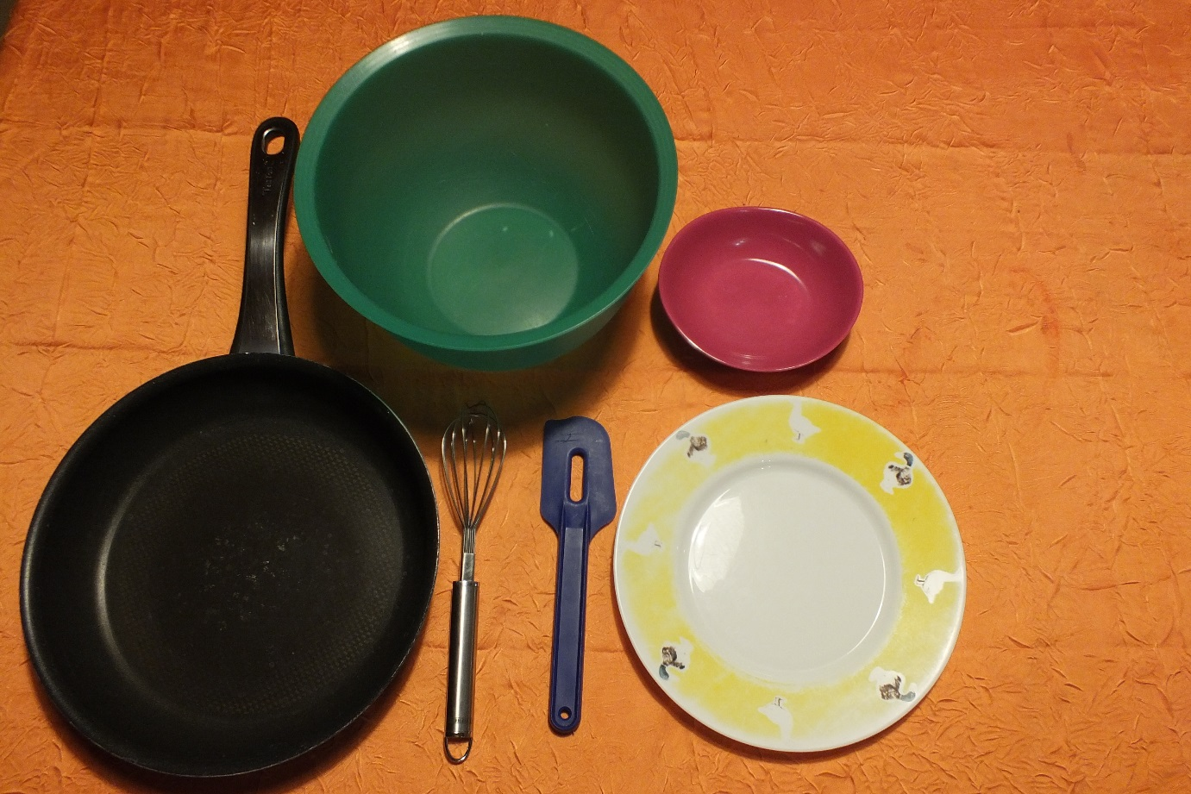
USTENSILS
- 1 small bowl - 1 large salad bowl - 1 spatula - 1 whisk - Some oil - 1 plate

Slide 4
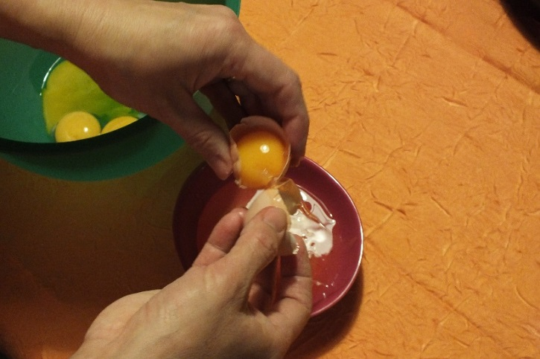
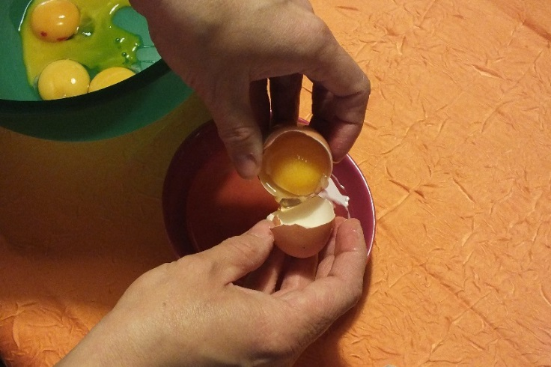
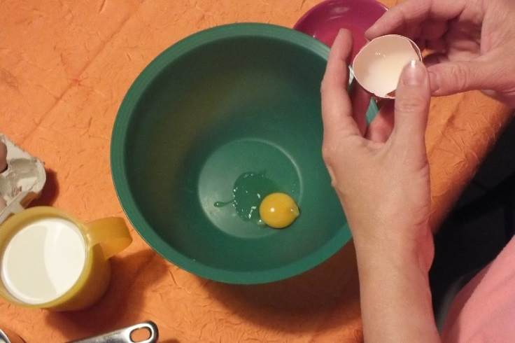
Step 1
Break the eggs, separate the yolks from the whites, the yolks in the bowl and the whites in small bowl.

Slide 5
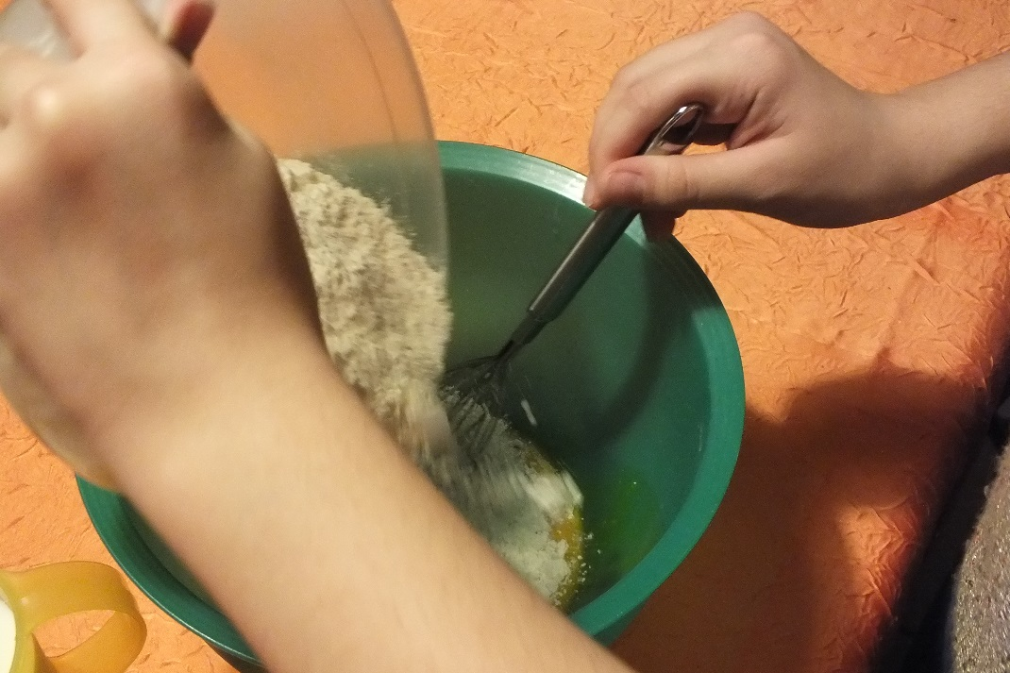
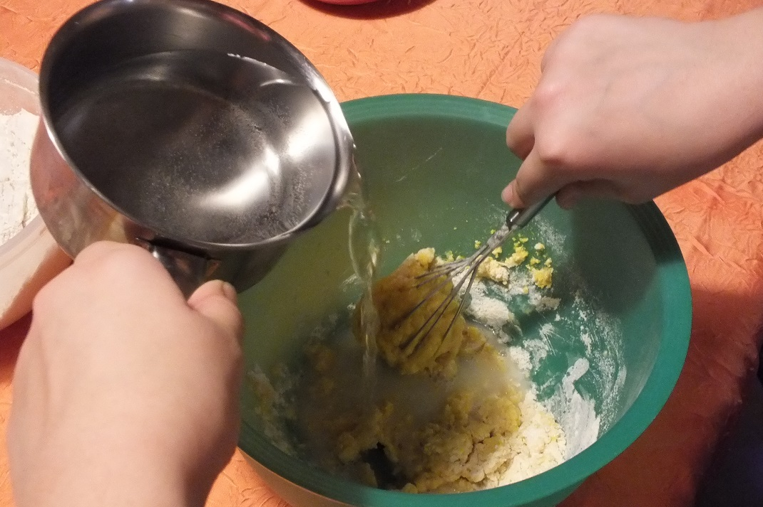
Step 2
Add the flour into the bowl and mix with the whisk by adding warm water as you go.

Slide 6
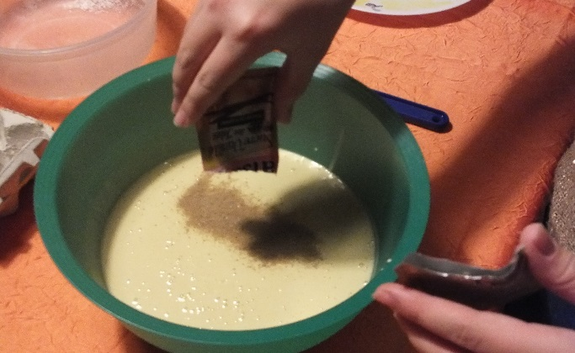
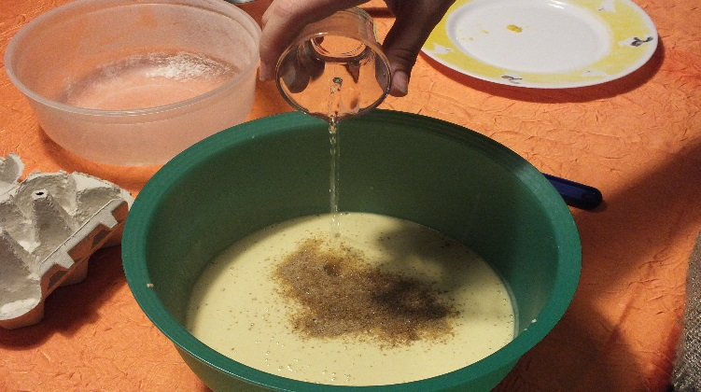
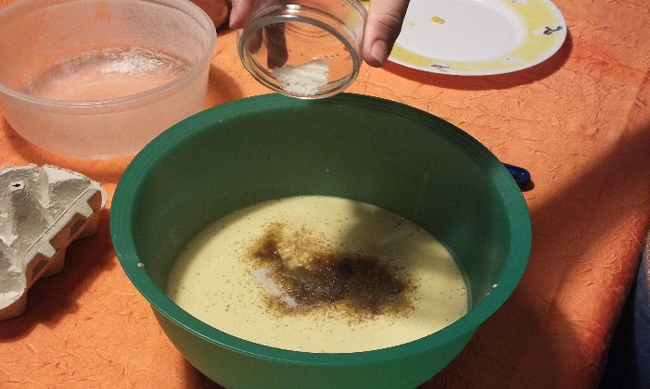
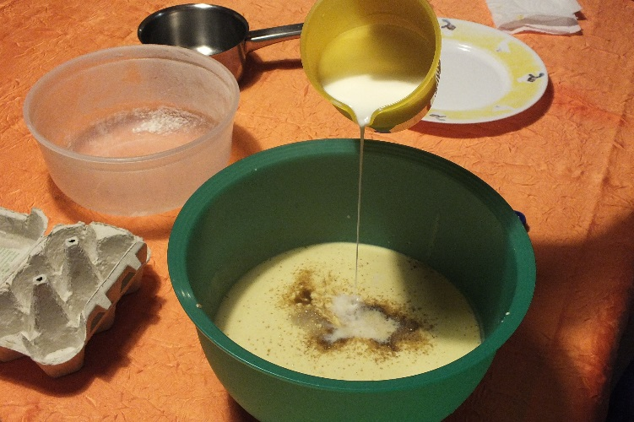
Step 3
Add the vanilla sugar, rum, salt and milk gradually and continue mixing.

Slide 7
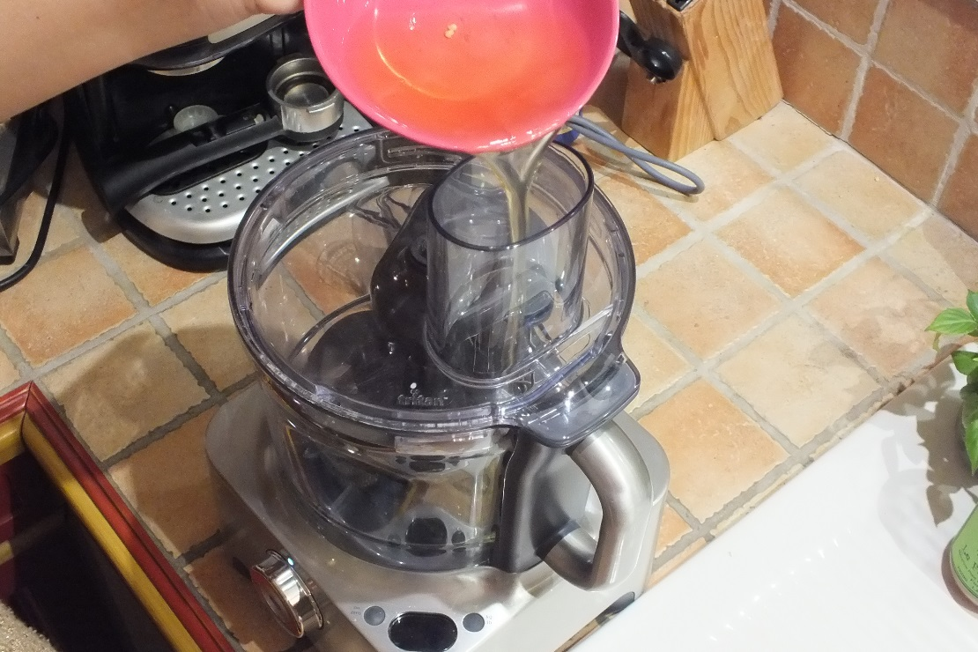
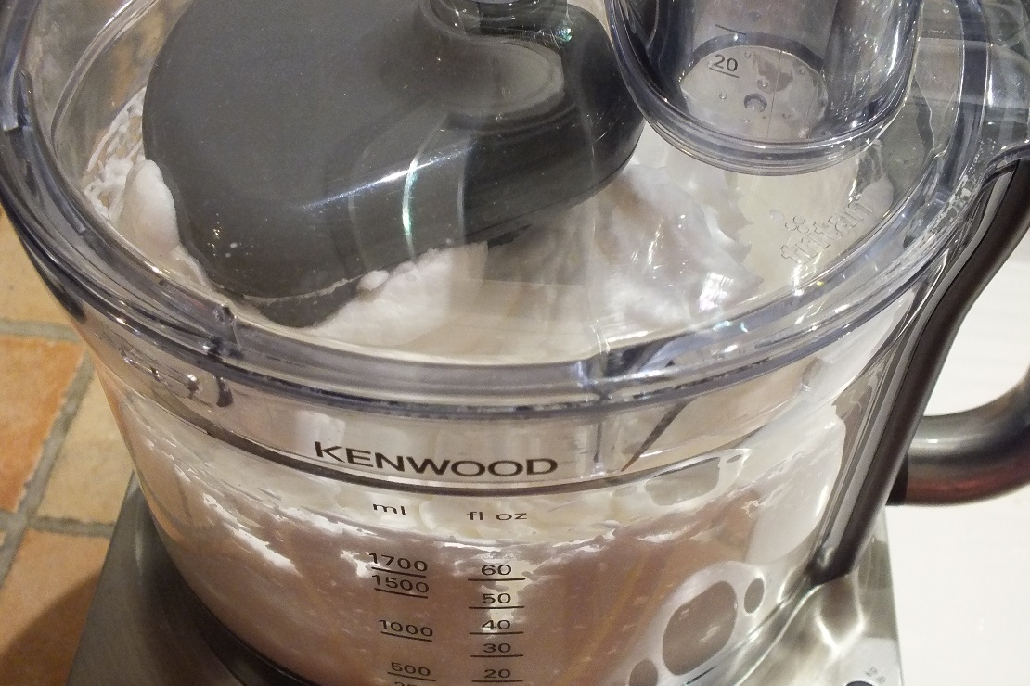
Step 4
Take the egg whites and pour them into the mixer bowl and beat them until stiff.

Slide 8
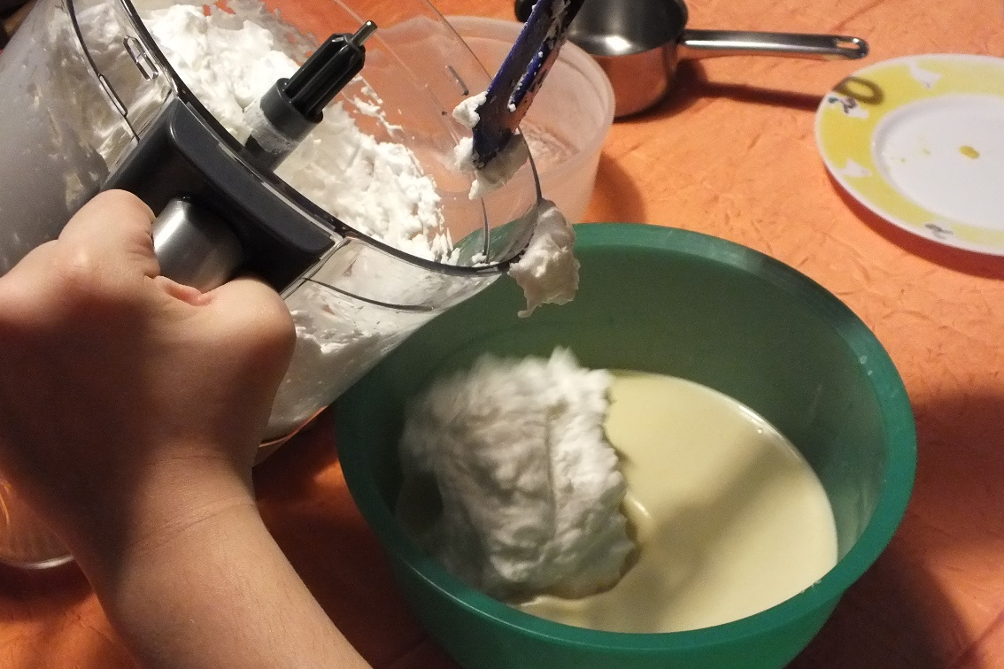
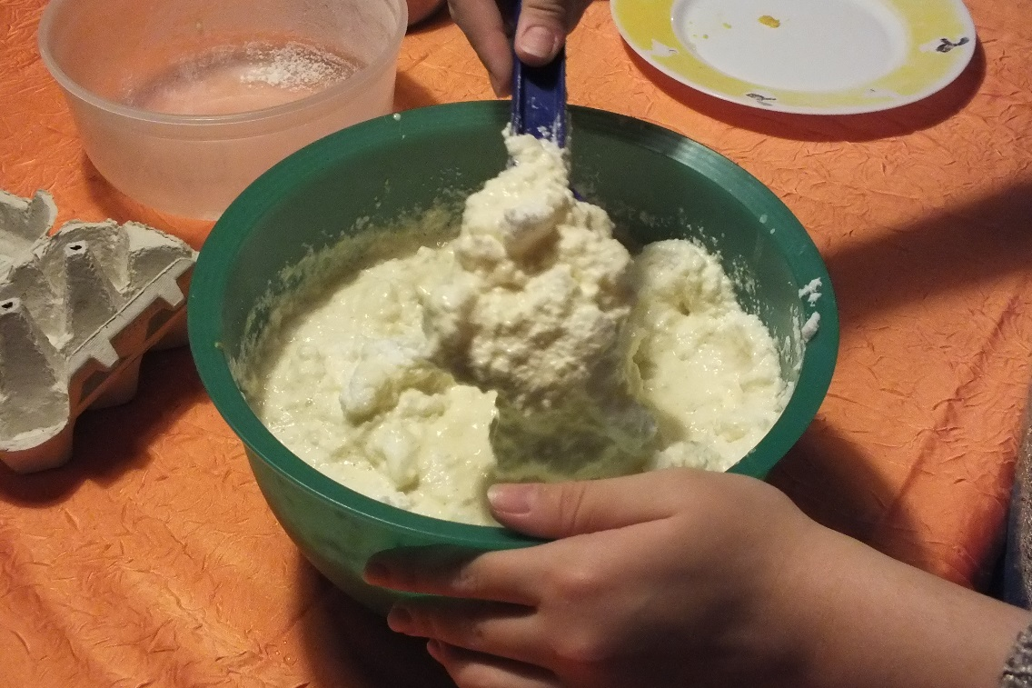
Step 5
Add the egg whites in the bowl slowly and mix with the batter.

Slide 9
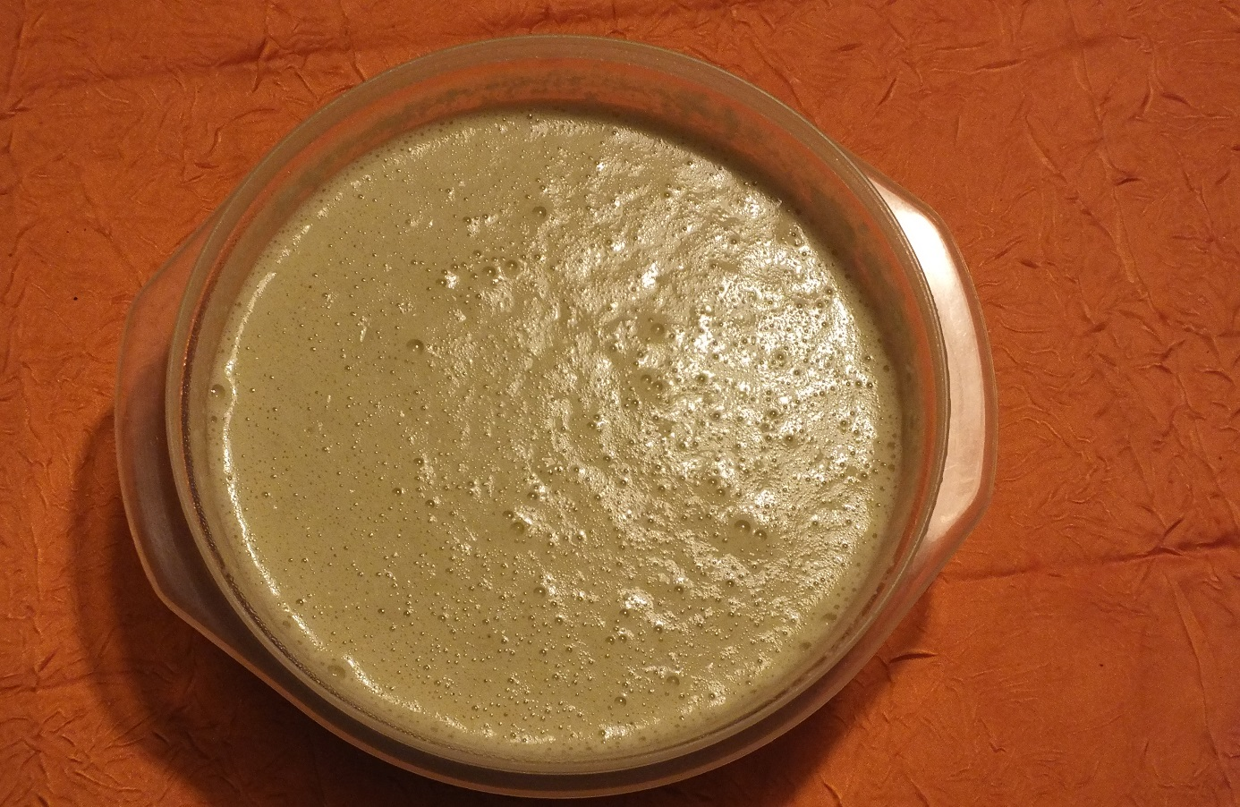
Step 6
When the batter is well mixed, let it rest at least 4 hours .

Slide 10
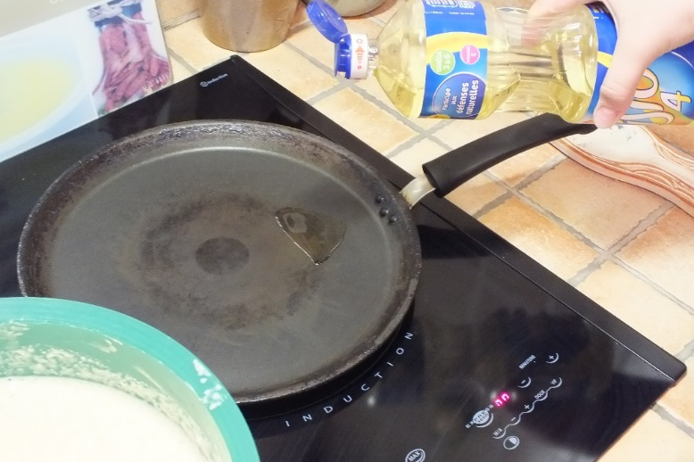
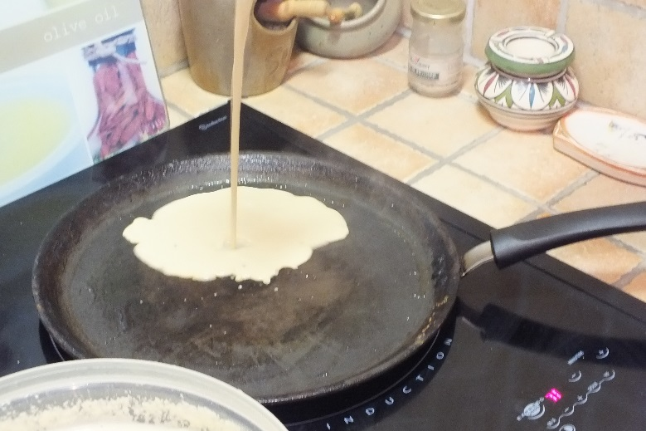
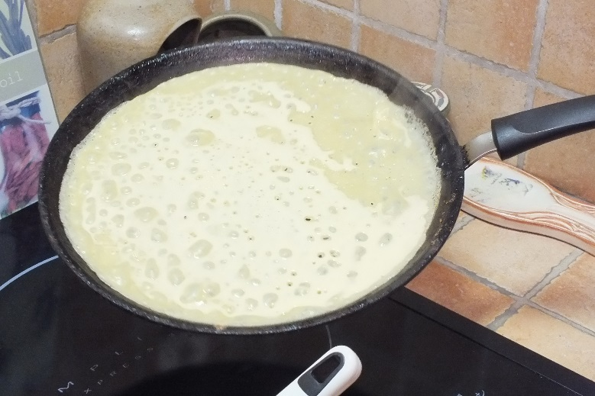
Step 7
Then take a frying pan over high heat and add a teaspoon of oil, and when hot, pour a ladle of batter which is spread in the stove.

Slide 11
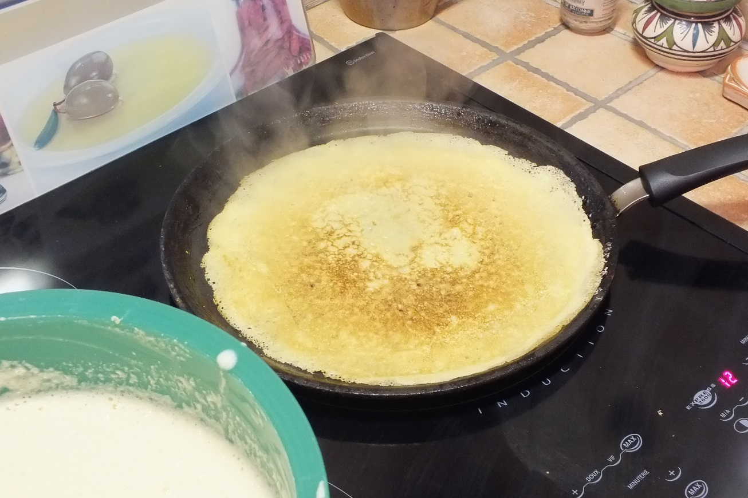
Step 8
Toss the pancake after a few minutes and cook again.

Slide 12
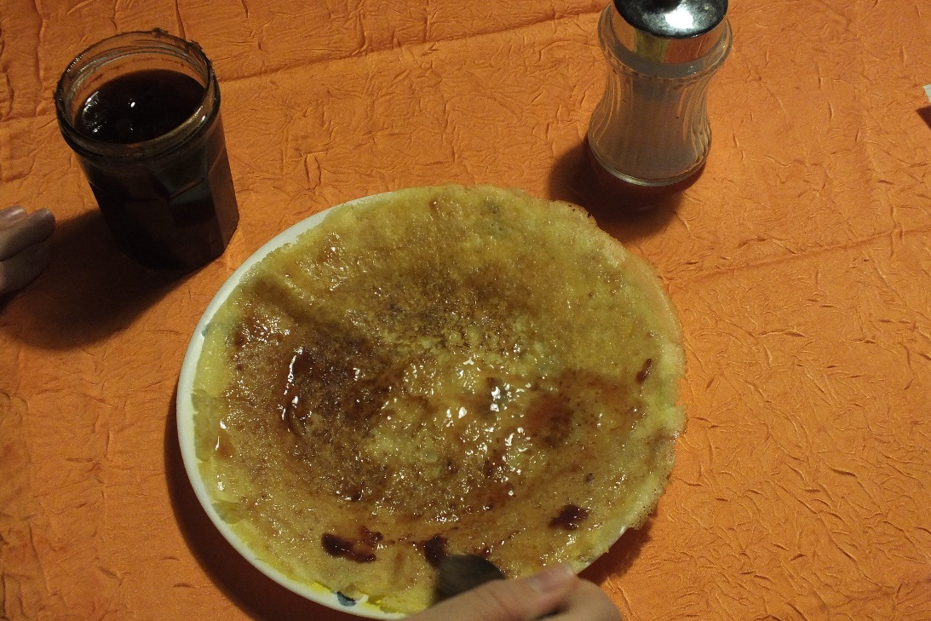
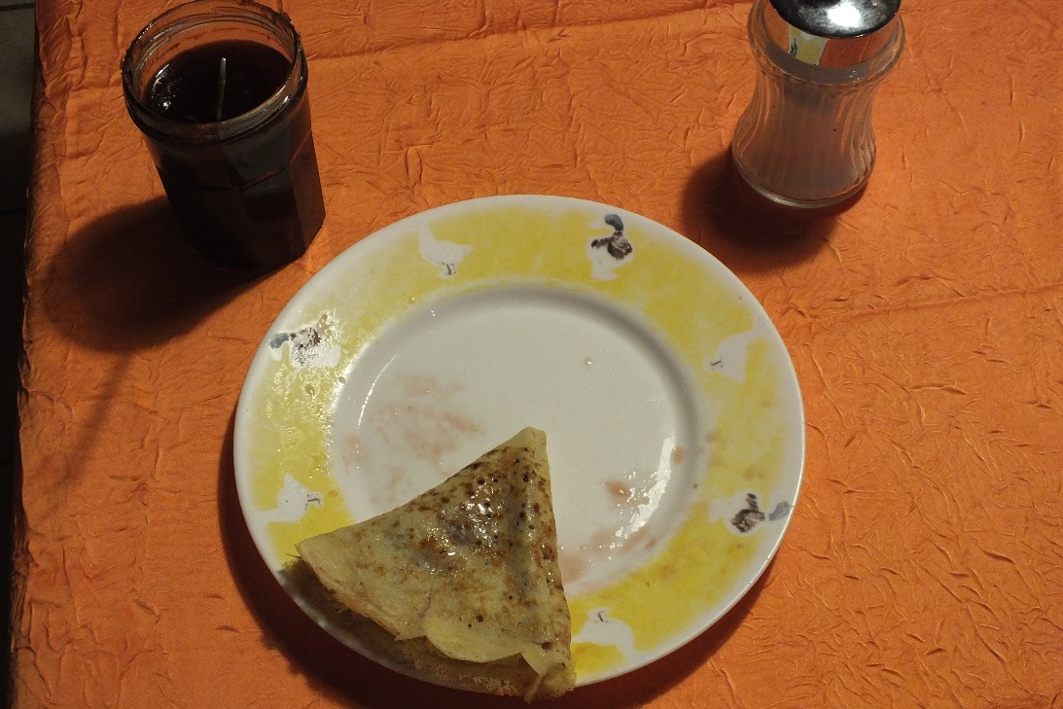
Step 9
Then turn the pancakes on a plate and spread sugar or jam and enjoy.

Slide 13
Step 10
And ENJOY !

