Slide 1
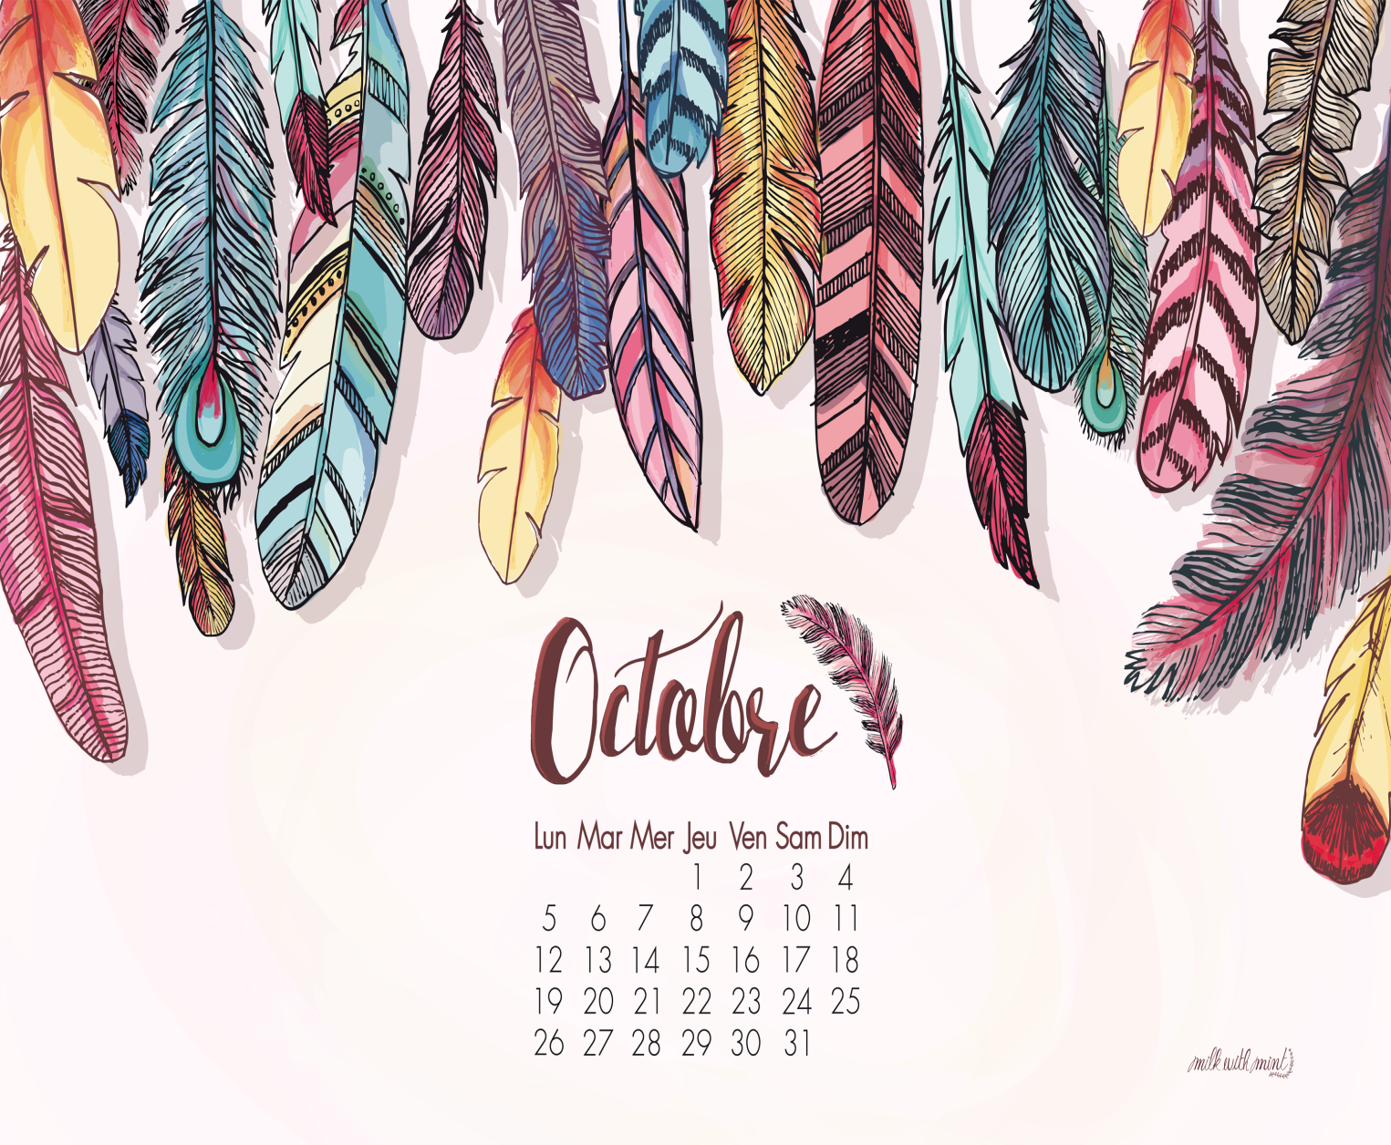
MONDAY
dimanche
SATURDAY
jeudi
DAYS OF THE WEEK
vendredi
lundi
A WEEK
mardi
TUESDAY
SUNDAY
La semaine
Samedi
WEDNESDAY
THURSDAY
FRIDAY
mercredi

Slide 2
A RECTANGLE
A TRIANGLE
GEOMETRIC SHAPES
A CIRCLE
A SQUARE
A STAR
A DIAMOND
AN OVAL
A HEART

Slide 3
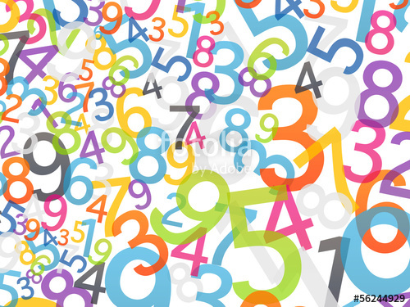
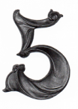
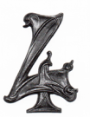
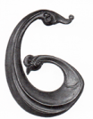
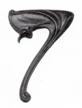
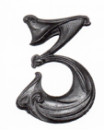
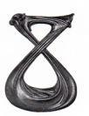
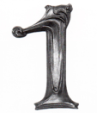
ONE
SEVEN
NUMBERS (1)
TWO
THREE
SIX
FIVE
FOUR
EIGHT

Slide 4
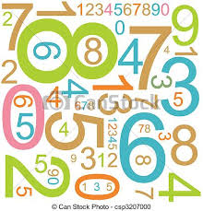
TEN
TWENTY
THIRTY
NUMBERS (2)
SEVENTY
FORTY
EIGHTY
FIFTY
SIXTY

